Slide 1
ASP.NET MVC 5
02 Jan18 | Start
08 May 18 | 1: 4-19
09 May 18 | 1: 20-44
25 May 18 | 14:
Appendix
Online

Slide 2
MVC 5
Ch | Date
1 | 08 May 18
2
3
4
5
6
7
8
Pro ASP.NET MVC 5 2013

Slide 3
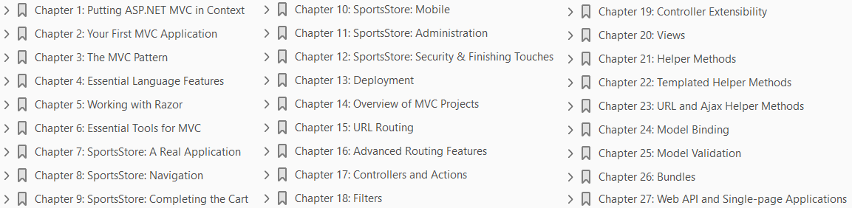

Slide 4
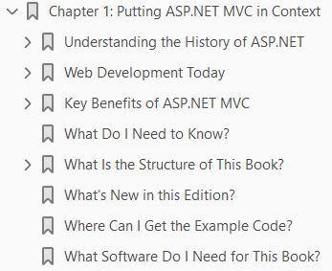
1
Putting ASP.NET MVC in Context

Slide 5
Intro
ASP.NET MVC is a Web development framework from Microsoft that combines
the effectiveness and tidiness of model-view-controller (MVC) architecture,
the most up-to-date ideas and techniques from agile development, and
the best parts of the existing ASP.NET platform.
It is a complete alternative to traditional ASP.NET Web Forms, delivering advantages for all but the most trivial of Web development projects.
In this chapter, you’ll learn why Microsoft created ASP.NET MVC, how it compares to its predecessors and alternatives, and, finally, what’s new in ASP.NET MVC 5 and what’s covered in this book.

Slide 6
Understanding the History of ASP.NET
ASP.NET was a huge shift when it first arrived in 2002.
Figure 1-1 illustrates Microsoft’s technology stack as it appeared then.
With Web Forms, Microsoft attempted to hide both HTTP (with its intrinsic statelessness) and HTML(which at the time was unfamiliar to many developers) by modeling the user interface (UI) as a hierarchy of server-side control objects.
Each control kept track of its own state across requests (using the View State facility), rendering itself as HTML when needed and automatically connecting client-side events (for example, a button click) with the corresponding server-side event handler code.
In effect, Web Forms is a giant abstraction layer designed to deliver a classic event-driven graphical user interface (GUI) over the Web.
The idea was to make Web development feel just the same as Windows Forms development.
Developers didn’t need to work with a series of independent HTTP requests and responses.
They could think in terms of a stateful UI, and Microsoft could seamlessly transition the army of Windows desktop developers into the new world of web applications.

Slide 7
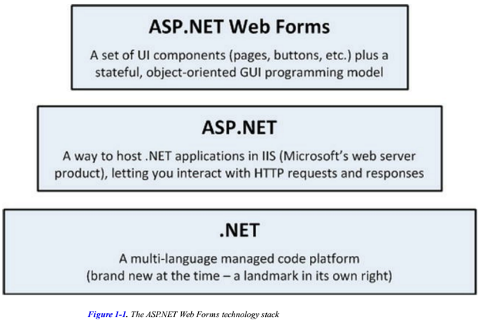
Figure 1-1

Slide 8
What Is Wrong with ASP.NET Web Forms?
Traditional ASP.NET Web Forms development was great in principle, but reality proved more complicated:
View State weight: The actual mechanism for maintaining state across requests (known as View State) results in large blocks of data being transferred between the client and server.
This data can reach hundreds of kilobytes in even modest Web applications, and it goes back and forth with every request, leading to slower response times and increasing the bandwidth demands of the server.
Page life cycle: The mechanism for connecting client-side events with server-side event handler code, part of the page life cycle, can be extraordinarily complicated and delicate.
Few developers have success manipulating the control hierarchy at runtime without getting View State errors or finding that some event handlers mysteriously fail to execute.
False sense of separation of concerns: ASP.NET Web Forms’ code-behind model provides a means to take application code out of its HTML markup and into a separate code-behind class.
This has been widely applauded for separating logic and presentation, but, in reality, developers are encouraged to mix presentation code (for example, manipulating the server-side control tree) with their application logic (for example, manipulating database data) in these same monstrous code-behind classes.
The end result can be fragile and unintelligible.

Slide 9
What Is Wrong with ASP.NET Web Forms? |
Limited control over HTML: Server controls render themselves as HTML, but not necessarily the HTML you want.
In early versions of ASP.NET, the HTML output failed to meet with Web standards or make good use of Cascading Style Sheets (CSS), and server controls generated unpredictable and complex ID attribute values that are hard to access using JavaScript.
These problems are much improved in recent Web Forms releases, but it can still be tricky to get the HTML you expect.
Leaky abstraction: Web Forms tries to hide HTML and HTTP wherever possible.
As you try to implement custom behaviors, you frequently fall out of the abstraction, which forces you to reverse-engineer the postback event mechanism or perform obtuse acts to make it generate the desired HTML.
Plus, all this abstraction can act as a frustrating barrier for competent Web developers.
Low testability: The designers of Web Forms could not have anticipated that automated testing would become an essential component of software development.
Not surprisingly, the tightly coupled architecture they designed is unsuitable for unit testing.
Integration testing can be a challenge, too.

Slide 10
What Is Wrong with ASP.NET Web Forms? ||
Web Forms isn’t all bad and Microsoft has put a lot of effort into
improving standards compliance
simplifying the development process
even taking some features from ASP.NET MVC
Web Forms excels when you need quick results, and you can have a reasonably complex web app up and running within a day.
But unless you are careful during development, you will find that the application you create is hard to test and hard to maintain.

Slide 11
Web Development Today
Outside Microsoft, Web development technology has been progressing rapidly and in several different directions since Web Forms was first released.
Web Standards and REST
Agile and Test-Driven Development
Ruby on Rails
Node.js (Node)

Slide 12
Web Standards and REST
The drive for Web standards compliance has increased in recent years.
Web sites are consumed on a greater variety of devices and browsers than ever before, and Web standards (HTML, CSS, JavaScript, and so forth) remain the great hope for enjoying a consistent browsing experience.
Modern web platforms can’t afford to ignore the business case and the weight of developer enthusiasm for Web standards compliance.
HTML5 has begun to enter mainstream use and provides the Web developer with rich capabilities that allow the client to perform work that was previously the exclusive responsibility of the server.
These new capabilities and the increasing maturity of JavaScript libraries such as
means that standards have become ever more important and form the critical foundation for ever richer Web apps.

Slide 13
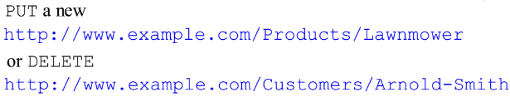
REST
At the same time, Representational State Transfer (REST has become the dominant architecture for application interoperability over HTTP, completely overshadowing SOAP (the technology behind ASP.NET’s original approach to Web services).
REST describes an application in terms of resources (URIs) representing real-world entities and standard operations (HTTP methods) representing available operations on those resources.
For example, you might
Today’s Web applications don’t serve just HTML. Often, they must also serve JSON or XML data to client technologies such as AJAX and native smartphone applications.
This happens naturally with REST, which eliminates the distinction between Web services and Web applications, but requires an approach to HTTP and URL handling that has not easily been supported by ASP.NET Web Forms.

Slide 14
Agile and Test-Driven Development
It is not just Web development that has matured.
Software development as a whole has shifted toward agile methodologies.
This can mean a lot of different things, but it is largely about running software projects as
adaptable processes of discovery
resisting excessive forward planning
Enthusiasm for agile methodologies tends to go hand-in-hand with a set of development practices and tools (usually open source) that promote and assist these practices.
Test-driven development (TDD), and its close relative, behavior-driven development (BDD), are two examples.
The idea is to design your software by first describing examples of desired behaviors (known as tests or specifications), so at any time you can verify the stability and correctness of your application by executing your suite of tests against the implementation.

Slide 15
TDD/BDD Tools
There’s no shortage of .NET tools to support TDD/BDD, but these tend to not work well with Web Forms:
Unit testing tools let you specify the behavior of individual classes or other small code units in isolation.
These can be effectively applied only to software that has been designed as a set of independent modules, so that each test can be run in isolation.
Unfortunately, few Web Forms applications can be tested this way.
UI automation tools let you simulate a series of user interactions against a complete running instance of your application.
These can be used with Web Forms, but they can break down whenever you make a slight change to your page layout.
Without special attention, Web Forms change the HTML structures and element IDs, breaking test suites.
The .NET open source and independent software vendor (ISV community has produced no end of top quality
unit testing frameworks (NUnit and xUnit)
mocking frameworks (Moq and Rhino Mocks)
inversion-of-control containers (Ninject and AutoFac)

Slide 16
TDD/BDD Tools |
continuous integration servers (Cruise Control and TeamCity),
object-relational mappers (NHibernate and Subsonic), and the like.
Traditional ASP.NET Web Forms is not amenable to these tools and techniques because of its monolithic design, and so Web Forms gets little respect from these projects.

Slide 17
Ruby on Rails
In 2004, Ruby on Rails was a quiet, open source contribution from an unknown player.
Suddenly fame hit, transforming the rules of Web development.
It’s not that Ruby on Rails contained revolutionary technology but that the concept took existing ingredients and blended them in such a compelling and appealing way as to put existing platforms to shame.
Ruby on Rails (or just Rails, as it is commonly called) embraced an MVC architecture, which I describe in Chapter 3.
By applying MVC and working in tune with the HTTP protocol, by promoting conventions instead of the need for configuration, and by integrating an object-relational mapping (ORM) tool into its core, Rails applications more or less fell into place without much effort.
It was as if this was how Web development should have been all along.
Rails showed that Web standards compliance and RESTfulness don’t need to be hard.
It also showed that agile development and TDD work best when the framework is designed to support them.
The rest of the Web development world has been catching up ever since.

Slide 18
Node.js
Another significant trend is the movement toward using JavaScript as a primary programming language.
AJAX first showed that JavaScript is important
jQuery showed us that it could be powerful and elegant
Google’s open source V8 JavaScript engine showed us that it could be fast
Today, JavaScript is becoming a serious server-side programming language.
It serves as the data storage and querying language for several non-relational databases, including CouchDB and Mongo, and it is used as a general-purpose language in server-side platforms such as Node.js.
Node.js has been around since 2009 and gained acceptance quickly.
Its key innovations are as follows:
Using JavaScript: Developers need to work only in a single language, from clientside code, through server-side logic, and even into data-querying logic via CouchDB or the like.
Being completely asynchronous: Node.js’s core API doesn’t expose any way of blocking a thread while waiting for input/output (I/O) or any other operation.
All I/O is implemented by beginning the operation and then later receiving a callback when the I/O is completed.

Slide 19
Node.js |
This means that Node.js makes extremely efficient use of system resources and may handle tens of thousands of concurrent requests per CPU. (Alternative platforms tend to be limited to about one hundred concurrent requests per CPU.)
Node.js remains a niche technology.
Its biggest contribution to web app development has, rather oddly, been to provide a consistent JavaScript engine on which development tools can be written.
Many emerging client-side JavaScript frameworks, such as AngularJS, have good tooling support based on the use of Node.js.
Node.js adoption for deploying web apps has been slower.
Most businesses building real applications in limited time frames typically need the infrastructure in full-stack frameworks such as Ruby on Rails and ASP.NET MVC.
Node.js is mentioned here only to put some of ASP.NET MVC’s design into context against industry trends.
For example, ASP.NET MVC includes asynchronous controllers (which I describe in Chapter 19).
This is a way to handle HTTP requests with non-blocking I/O and scale up to handle more requests per CPU.

Slide 20
Key Benefits of ASP.NET MVC
In October 2007, Microsoft announced a new MVC Web development platform, built on the core ASP.NET platform, clearly designed as a direct response to
the evolution of technologies such as Rails
as a reaction to the criticisms of Web Forms
The following sections describe how this new platform overcame the Web Forms limitations and brought ASP.NET back to the cutting edge.

Slide 21
MVC Architecture
It is important to distinguish between the MVC architectural pattern and the ASP.NET MVC Framework.
The MVC pattern is not new—it dates back to 1978 and the Smalltalk project at Xerox PARC—but it has gained enormous popularity today as a pattern for Web applications, for the following reasons:
User interaction with an MVC application follows a natural cycle: the user takes an action, and in response the application changes its data model and delivers an updated view to the user.
And then the cycle repeats. This is a convenient fit for Web applications delivered as a series of HTTP requests and responses.
Web applications necessitate combining several technologies (databases, HTML, and executable code, for example), usually split into a set of tiers or layers.
The patterns that arise from these combinations map naturally onto the concepts in MVC.
The ASP.NET MVC Framework implements the MVC pattern and, in doing so, provides greatly improved separation of concerns.
In fact, ASP.NET MVC implements a modern variant of the MVC pattern that is especially suitable for Web applications.
You will learn more about the theory and practice of this architecture in Chapter 3.

Slide 22
MVC Architecture |
By embracing and adapting the MVC pattern, the ASP.NET MVC Framework provides strong competition to Ruby on Rails and similar platforms, and brings the MVC pattern into the mainstream of the .NET world.
By capitalizing on the experience and best practices discovered by developers using other platforms, ASP.NET MVC has, in many ways, pushed forward beyond what even Rails can offer.

Slide 23
Extensibility
The MVC Framework is built as a series of independent components that satisfy a .NET interface or that are built on an abstract base class.
You can easily replace components, such as
the routing system
the view engine
the controller factory
with a different one of your own implementation.
In general, the MVC Framework gives you three options for each component:
Use the default implementation of the component as it stands (which should be enough for most applications)
Derive a subclass of the default implementation to tweak its behavior
Replace the component entirely with a new implementation of the interface or abstract base class
You’ll learn all about the various components, and how and why you might want to tweak or replace each of them, starting in Chapter 14.

Slide 24
Tight Control over HTML and HTTP
ASP.NET MVC produces clean, standards-compliant markup.
Its built-in HTML helper methods produce standards-compliant output, but there is a more significant philosophical change compared with Web Forms.
Instead of generating out swathes of HTML over which you have little control, the MVC Framework encourages you to craft simple, elegant markup styled with CSS.
Of course, if you do want to throw in some ready-made widgets for complex UI elements such as date pickers or cascading menus, ASP.NET MVC’s “no special requirements” approach to markup makes it easy to use best-of-breed UI libraries such as jQuery UI or the Bootstrap CSS library.
ASP.NET MVC meshes so well with jQuery, for example, that Microsoft ships jQuery as a built-in part of the default Visual Studio ASP.NET MVC project template, along with other popular libraries, such as
Bootstrap
Knockout
Modernizr
ASP.NET MVC–generated pages don’t contain any View State data, so they are smaller than typical pages from ASP.NET Web Forms.

Slide 25
Tight Control over HTML and HTTP |
Despite today’s fast connections, this economy of bandwidth still gives an enormously improved end-user experience and helps reduce the cost of running a popular web application.
ASP.NET MVC works in tune with HTTP.
You have control over the requests passing between the browser and server, so you can fine-tune your user experience as much as you like.
AJAX is made easy, and there aren’t any automatic postbacks to interfere with client-side state.

Slide 26
NOTE
I don’t get into the detail of these “blessed” JavaScript libraries in this book because they are not part of the core MVC Framework and do their work within the browser.
Client-side development for MVC Framework applications is an important topic, however, and you can learn more in my book Pro ASP.NET MVC 5 Client, which will be published by Apress in 2014.
There are some libraries, however, that provide support for core features such as validation and Ajax requests and I describe these in Part 2 of this book.
I describe Knockout in Chapter 27 and I use Bootstrap (albeit without a detailed introduction) throughout the book.

Slide 27
Testability
The MVC architecture gives you a great start in making your application maintainable and testable because you naturally separate different application concerns into independent pieces.
Yet the ASP.NET MVC designers didn’t stop there.
To support unit testing, they took the framework’s component-oriented design and made sure that each separate piece is structured to meet the requirements of
unit testing
mocking tools
They added Visual Studio wizards to create unit test projects on your behalf, which can be integrated with open source unit test tools such as NUnit and xUnit as well as the test tools that are included in Visual Studio, which I introduce in Chapter 6.
Even if you have never written a unit test before, you will be off to a great start.
In this book, you will see examples of how to write clean, simple unit tests for ASP.NET MVC controllers and actions that supply fake or mock implementations of framework components to simulate any scenario, using a variety of testing and mocking strategies.
Testability is not only a matter of unit testing. ASP.NET MVC applications work well with UI automation testing tools, too.

Slide 28
Testability |
You can write test scripts that simulate user interactions without needing to guess which HTML element structures, CSS classes, or IDs the framework will generate, and you do not have to worry about the structure changing unexpectedly.

Slide 29
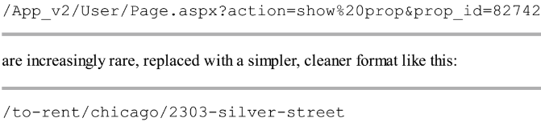
Powerful Routing System
The style of URLs has evolved as Web application technology has improved. URLs like this one:
There are some good reasons for caring about the structure of URLs.
First, search engines give weight to keywords found in a URL. A search for “rent in Chicago” is much more likely to turn up the simpler URL.
Second, many Web users are now savvy enough to understand a URL, and appreciate the option of navigating by typing it into their browser’s address bar.
Third, when someone understands the structure of a URL, they are more likely to link to it, share it with a friend, or even read it aloud over the phone.
Fourth, it doesn’t expose the technical details, folder, and file name structure of your application to the public Internet, so you are free to change the underlying implementation without breaking all your incoming links.

Slide 30
Powerful Routing System |
Clean URLs were hard to implement in earlier frameworks, but ASP.NET MVC uses a feature known as URL routing to provide clean URLs by default.
This gives you control over your URL schema and its relationship to your application, offering you the freedom to create a pattern of URLs that is meaningful and useful to your users, without the need to conform to a predefined pattern.
And, of course, this means you can easily define a modern REST-style URL schema if you wish.
You’ll find a thorough description of URL routing in Chapters 15 and 16.

Slide 31
Built on the Best Parts of ASP.NET Platform
Microsoft’s existing ASP.NET platform provides
a mature
well-proven set of components
facilities for developing effective and efficient Web applications
First and most obviously, as ASP.NET MVC is based on the .NET platform, you have the flexibility to write code in any .NET language and access the same API features—not just in MVC itself but in the extensive .NET class library and the vast ecosystem of third-party .NET libraries.
Second, ready-made ASP.NET platform features—such as
Authentication Membership
Roles Profiles
Internationalization
can reduce the amount of code you need to develop and maintain any Web application, and these features are just as effective when used in the MVC Framework as they are in a classic Web Forms project.
The underlying ASP.NET platform provides a rich set of tools on which to build web applications with the MVC Framework.

Slide 32
Note
I describe the most commonly used ASP.NET Platform features as they relate to MVC development in this book, but the platform is a topic in its own right.
For complete details of the rich features that the ASP.NET platform provides, see my forthcoming Pro ASP.NET MVC 5 Platform, which will be published by Apress in 2014.

Slide 33
Modern API
Microsoft’s .NET platform has evolved with each major release, supporting – and even defining – the state-of-the-art aspects of modern programming.
ASP.NET MVC 5 is built for .NET 4.5.1, so its API can take full advantage of recent language and runtime innovations, including the
await keyword
extension methods
lambda expressions
anonymous and dynamic types
Language Integrated Query (LINQ)
Many of the MVC Framework’s API methods and coding patterns follow
a cleaner
more expressive composition
than was possible with earlier platforms.
Don’t worry if you are not up to speed on the latest C# language features: I provide a summary of the most important C# features for MVC development in Chapter 4.

Slide 34
ASP.NET MVC Is Open Source
Unlike previous Microsoft Web development platforms, you are free to download the original source code for ASP.NET MVC, and even modify and compile your own version of it.
This is invaluable when your debugging trail leads into a system component and you want to step into its code (and even read the original programmers’ comments).
It is also useful if you are building an advanced component and want to see what development possibilities exist, or how the built-in components actually work.
Additionally, this ability is great if you do not like the way something works, if you find a bug, or if you just want to access something that’s otherwise inaccessible, because you can simply change it yourself.
However, you’ll need to keep track of your changes and reapply them if you upgrade to a newer version of the framework.
ASP.NET MVC is licensed under the Microsoft Public License (Ms-PL, http://www.opensource.org/licenses/ms-pl.html), an Open Source Initiative (OSI)–approved open source license.
This means that you can change the source code, deploy it, and even redistribute your changes publicly as a derivative project.
You can download the MVC source code from http://aspnetwebstack.codeplex.com.

Slide 35
What Do I Need to Know?
To get the most from this book, you should be familiar with
the basics of web development
have an understanding of how HTMLand CSS work
a working knowledge of C#
Don’t worry if you are a little hazy on the client-side details.
My emphasis is on server-side development in this book and you can pick up what you need through the examples.
In Chapter 4, I provide a summary of the most useful C# language features for MVC development, which you’ll find useful if you are moving to the latest .NET versions from an earlier release.

Slide 36
What Is the Structure of This Book?
This book is split into 2 parts, each of which covers a set of related topics.
Part 1: Introducing ASP.NET MVC 5
I start this book by putting the ASP.NET MVC Framework in context.
I explain the benefits and practical impact of the MVC pattern,
the way in which the MVC Framework fits into modern web development
describe the tools and C# language features that every MVC Framework programmer needs
In the next chapter you will dive right in and create a simple web application and get an idea of what the major components and building blocks are and how they fit together.
Most of this part of the book, however, is given over to the development of a project called SportsStore, through which I show you a realistic development process from inception to deployment, touching on the major features of the ASP.NET MVC Framework.
Part 2: ASP.NET MVC in Detail
In Part 2, I explain the inner workings of the MVC Framework features that I used to build the SportsStore application.

Slide 37
What Is the Structure of This Book? |
I show you how each feature works, explain the role it plays in the MVC Framework and show you the configuration and customization options that are available.
Having set the broad context in Part 1, I dig right into the details in Part 2.

Slide 38
What’s New in this Edition?
Version 5 of the MVC Framework is a relatively minor upgrade and a lot of the changes are really to do with the way that ASP.NET projects are created and managed in Visual Studio.
Table 1-1 briefly describes the new MVC Framework features and details where you can find more information about them in this book.
ASP.NET version 4.5.1, on which the MVC 5 is built, has been enhanced as well.
The most important change is the addition of the ASP.NET Identity API, which replaces the Membership system for managing user credentials.
I don’t cover ASP.NET Identity in this book, although I do explain how authentication and authorization are applied to MVC Framework applications through the use of features like filters.
A new edition is a chance to go beyond writing about new features and I have made some other changes for this book.
I have expanded the SportsStore example to show the basics of responsive and mobile web application development, I added quick references to the start of all the in-depth chapters so you can find easily specific examples, and I added a chapter that shows how one of the open source libraries that Microsoft has embraced—Knockout—can be combined with the Web API feature to create Single-Page Applications (SPAs).

Slide 39
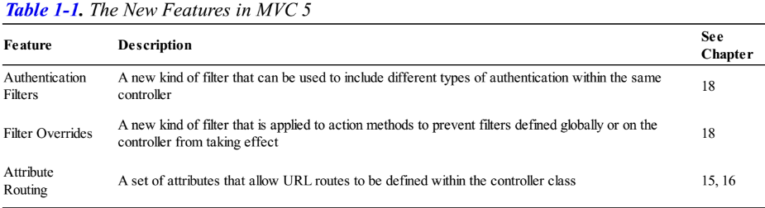
Table 1-1

Slide 40
NOTE
I will be covering ASP.NET Identity in my Pro ASP.NET MVC 5 Platform book, which will be published in 2014 and cover all of the facilities that the ASP.NET platform provides.
That said, I don’t want you to have to buy a second book to learn about something as important as user security, and so Apress has agreed to distribute the security-related chapters from that book from its web site for download without charge when that book is published.
Those chapters won’t be available immediately because I have not written the platform book yet, but it is my next major writing project after this book and my hope is that the delay won’t be too long.

Slide 41
Where Can I Get the Example Code?
You can download all of the examples for all of the chapters in this book from Apress.com.
The download is available without charge and includes all of the Visual Studio projects and their contents.
You don’t have to download the code, but it is the easiest way of experimenting with the examples and cutting and pasting techniques into your own projects.

Slide 42
What Software Do I Need for This Book?
The only software you need for MVC development is Visual Studio 2013, which contains everything you need to get started, including
a built-in application server for running and debugging MVC applications
an administration-free edition of SQL Server for developing database-driven applications
tools for unit testing
a code editor compiler and debugger
There are several different editions of Visual Studio, but I will be using the one that Microsoft makes available free of charge, called Visual Studio Express 2013 for Web.
Microsoft adds some nice features to the paid-for editions of Visual Studio, but you will not need them for this book and all of the figures that you see throughout this book have been taken using the Express edition, which you can download from http://www.microsoft.com/visualstudio/eng/products/visual-studioexpress-products.
There are several different versions of Visual Studio 2013 Express, each of which is used for a different kind of development.
Make sure that you get the Web version, which supports ASP/NET applications. Once you have installed Visual Studio, you are ready to go.

Slide 43
What Software Do I Need for This Book? |
Microsoft has improved the scope of the features in the Visual Studio Express in recent years and there is nothing else you need to follow along with this book.
I do rely on additional software packages, but these are installed through Visual Studio and don’t require separate downloads and installations (and are available without cost).

Slide 44
Credits
In Chapter 10, I use a feature of the Bootstrap CSS library called Glyphicons Halflings, which are a set of icons that are not usually available for free, but for which the creator has given an open license for their inclusion in Bootstrap.
The only request is that the creator’s URL be quoted when it is possible to do so, which seems like a fair and reasonable thing to do.
Here is it: http://glyphicons.com.

Slide 45
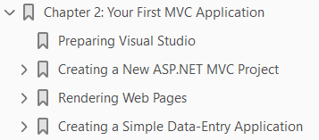
2
Your First MVC Application

Slide 46
Intro
The best way to appreciate a software development framework is to jump right in and use it.
In this chapter, you’ll create a simple data-entry application using the ASP.NET MVC Framework.
I take things a step at a time so you can see how an ASP.NET MVC application is constructed.
To keep things simple, I will skip over some of the technical details for the moment.
But don’t worry. If you are new to MVC, you will find plenty to keep you interested.
Where I use something without explaining it, I provide a reference to the chapter in which you can find all the details.

Slide 47
Preparing Visual Studio
Visual Studio Express contains all of the features you need to create, test and deploy an MVC Framework application, but some of those features are hidden away until you ask for them.
To enable all of the features, select Expert Settings from the Visual Studio Tools Settings menu.

Slide 48
TIP
For some reason, Microsoft has decided that the top-level menus in Visual Studio should be all in uppercase, which means that the menu I referred to is really TOOLS.
I think this is rather like shouting and I will capitalize menu names as Tools throughout this book.

Slide 49
Creating a New ASP.NET MVC Project
I am going to start by creating a new MVC Framework project in Visual Studio.
Select New Project from the File menu to open the New Project dialog.
If you select the Web templates in the Visual C# section, you will see the ASP.NET Web Application project template. Select this project type.
Set the name of the new project to PartyInvites and click the OK button to continue.
You will see another dialog box, which asks you to set the initial content for the ASP.NET project.
This is part of the Microsoft initiative to better integrate the different parts of ASP.NET into a set of consistent tools and templates.
The templates create projects with different starting points and configurations for features such as authentication, navigation and visual themes. I am going to keep things simple:
select the Empty option and check the MVC box in the Add folders and core references section.
This will create a basic MVC project with minimal predefined content and will be the starting point that I use for all of the examples in this book. Click the OK button to create the new project.
Once Visual Studio creates the project, you will see a number of files and folders displayed in the Solution Explorer window, as shown in Figure 2-3.

Slide 50
Creating a New ASP.NET MVC Project |
This is the default project structure for a new MVC project and you will soon understand the purpose of each of the files and folders that Visual Studio creates.
You can try to run the application now by selecting Start Debugging from the Debug menu (if it prompts you to enable debugging, just click the OK button).
Because I started with the empty project template, the application does not contain anything to run, so the server generates a 404 Not Found Error.
When you are finished, be sure to stop debugging by closing the browser window that shows the error, or by going back to Visual Studio and selecting Stop Debugging from the Debug menu.
As you have just seen, Visual Studio opens the browser to display the project.
The default browser is, of course, Internet Explorer, but you can select any browser that you have installed by using the toolbar.
As you can see, I have a range of browsers installed, which I find useful for testing web apps during development.
I will be using Internet Explorer 11 throughout this book, but that’s just because I know that IE is so widely installed.

Slide 51
Creating a New ASP.NET MVC Project ||
Internet Explorer used to play fast and loose with web standards, but recent versions have been good at implementing the HTML5 standard. Google Chrome is also a good choice for development and I tend to use it for my own projects.

Slide 52
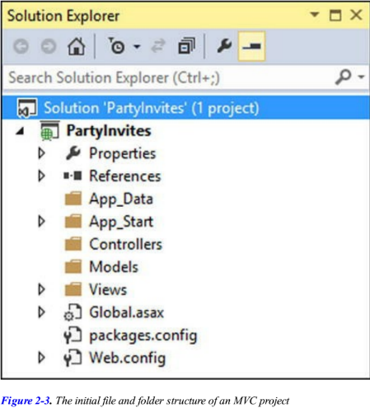
Figure 2-3

Slide 53
Adding the First Controller
In MVC architecture, incoming requests are handled by controllers.
In ASP.NET MVC, controllers are just C# classes (usually inheriting from System.Web.Mvc.Controller, the framework’s built-in controller base class).
Each public method in a controller is known as an action method, meaning you can invoke it from the Web via some URL to perform an action.
The MVC convention is to put controllers in the Controllers folder, which Visual Studio created when it set up the project.
To add a controller to the project, right-click the Controllers folder in the Visual Studio Solution Explorer window and choose Add and then Controller from the pop-up menus.
When the Add Scaffold dialog appears, select the MVC 5 Controller – Empty option, and click the Add button.
The Add Controller dialog will appear.
Set the name to HomeController and click the Add button.
There are several conventions represented in this name:
names given to controllers should indicate their purpose
the default controller is called Home and controller names have the suffix Controller

Slide 54
HomeController.cs
Visual Studio will create a new C# file in the Controllers folder called HomeController.cs and open it for editing.
I have listed the default contents that Visual Studio puts into the class file in Listing 2-1.
You can see that the class is called HomeController and it is derived from the Controller class, which is found in the System.Web.Mvc namespace.
A good way of getting started with MVC is to make a couple of simple changes to the controller class.
Edit the code in the HomeController.cs file so that it matches Listing 2-2.
I have highlighted the statements that have changed so they are easier to see.
These changes don’t have a dramatic effect, but they make for a nice demonstration.
I have changed the action method called Index so that it returns the string “Hello World”.
Run the project again by selecting Start Debugging from the Visual Studio Debug menu.
The browser will display the result of the Index action method.

Slide 55
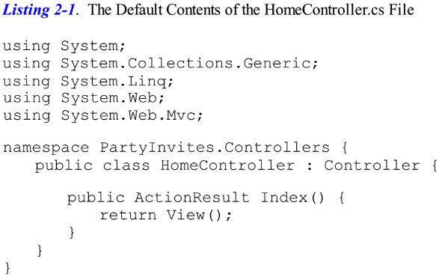
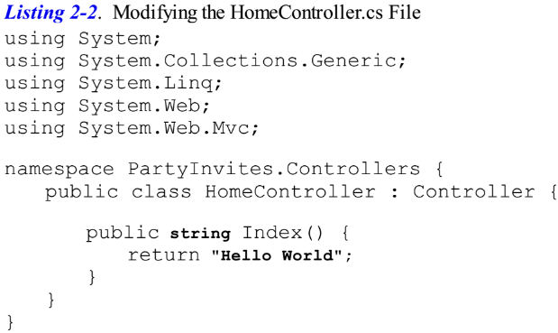
Listing 2-1 || 2-2

Slide 56
TIP
Notice that Visual Studio has directed the browser to port 37782.
You will almost certainly see a different port number in the URL that your browser requests because Visual Studio allocates a random port when the project is created.
If you look in the Windows task bar notification area, you will find an icon for IIS Express.
This is a cut-down version of the full IIS application server which is included with Visual Studio and is used to deliver ASP.NET content and services during development.
I’ll show you how to deploy an MVC project into a production environment in Chapter 13.

Slide 57
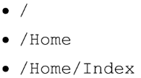
Understanding Routes
As well as models, views, and controllers, MVC applications use the ASP.NET routing system, which decides how URLs map to controllers and actions.
When Visual Studio creates the MVC project, it adds some default routes to get us started.
You can request any of the following URLs, and they will be directed to the Index action on the HomeController:
So, when a browser requests http://yoursite/ or http://yoursite/Home, it gets back the output from HomeController’s Index method.
You can try this yourself by changing the URL in the browser.
At the moment, it will be http://localhost:37782/, except that the port part may be different.
If you append /Home or /Home/Index to the URL and hit return, you will see the same Hello World result from the MVC application.

Slide 58
Understanding Routes |
This is a good example of benefiting from following MVC conventions.
In this case, the convention is that I will have a controller called HomeController and that it will be the starting point for my MVC application.
The default routes that Visual Studio creates for a new project assume that I will follow this convention.
And since I did follow the convention, I automatically got support for the URLs in the preceding list.
If I had not followed the convention, I would need to modify the routes to point to whatever controller I had created instead.
For this simple example, the default configuration is all I need.

Slide 59
Tip
You can see and edit your routing configuration by opening the RouteConfig.cs file in the App_Start folder.
I explain what the entries in this file do in Chapters 16 and 17.

Slide 60
Rendering Web Pages
The output from the previous example wasn’t HTML—it was just the string “Hello World”.
To produce an HTML response to a browser request, I need a view.

Slide 61
Creating and Rendering a View
The first thing I need to do is modify my Index action method, as shown in Listing 2-3.
The changes in Listing 2-3 are shown in bold.
When I return a ViewResult object from an action method, I am instructing MVC to render a view.
I create the ViewResult by calling the View method with no parameters.
This tells MVC to render the default view for the action.
If you run the application at this point, you can see the MVC Framework trying to find a default view to use, as shown in the error message displayed in Figure 2-9.
This error message is quite helpful.
It explains not only that MVC could not find a view for the action method, but it shows where it looked.
This is another nice illustration of an MVC convention: views are associated with action methods by a naming convention.
The action method is called Index and the controller is called Home and you can see from Figure 2-9 that MVC is trying to find different files in the Views folder that have that name.
The simplest way to create a view is to ask Visual Studio to do it for you.
Right-click anywhere in the definition of the Index action method in code editor window for the HomeController.cs file and select Add View from the pop-up menu.

Slide 62
Creating and Rendering a View |
Visual Studio displays the Add View dialog, which allows you to configure the initial contents of the view file that will be created.
Set View Name to Index (the name of the action method that the view will be associated with—another convention), set Template to Empty (without model), and leave the Create as a partial view and Use a layout page boxes unchecked, as shown in Figure 2-11.
Don’t worry about what all of these options mean at the moment —I’ll explain all of the details in later chapters.
Click the Add button to create the new view file.
Visual Studio will create a file called Index.cshtml in the Views/Home folder.
If this isn’t the effect you achieve, then delete the file you created and try again.
This is another MVC Framework convention: views are placed in the Views folder, organized in folders that correspond to the name of the controller they are associated with.
The effect of the values I told you to enter into the Add View dialog tell Visual Studio to create the most basic view, the contents of which are shown in Listing 2-4.

Slide 63
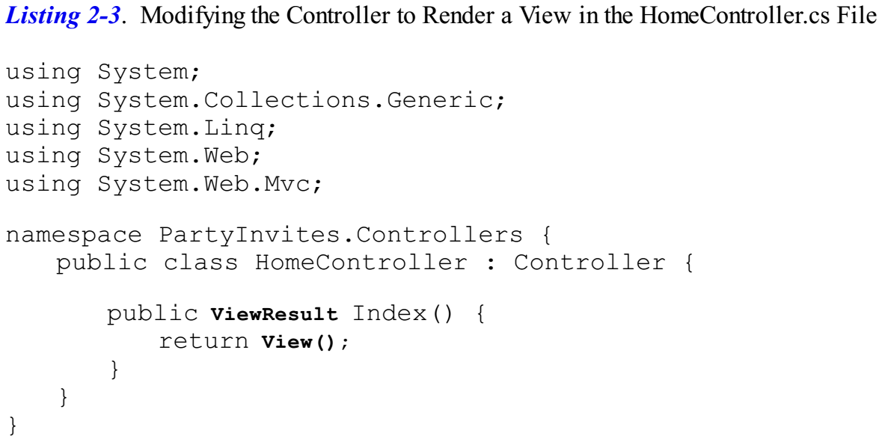
Listing 2-3

Slide 64
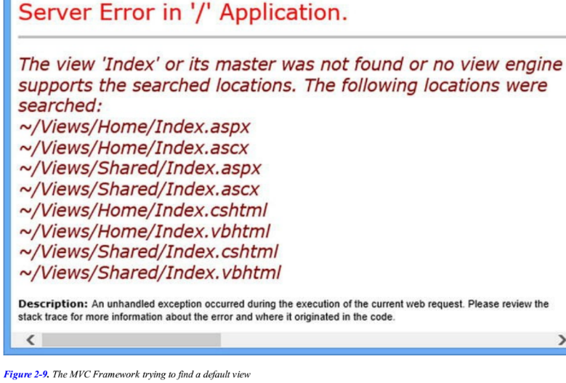
Figure 2-9

Slide 65
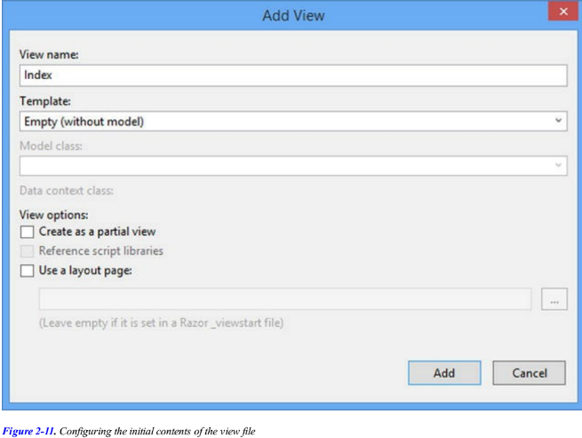
Figure 2-11

Slide 66
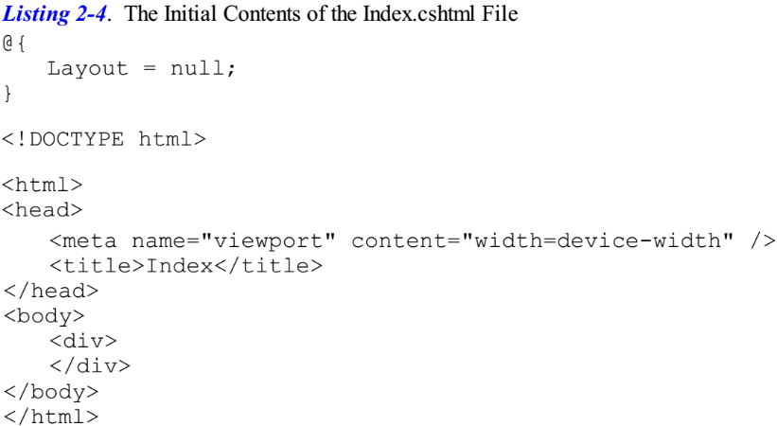
Listing 2-4

Slide 67
Tip
The .cshtml file extension denotes a C# view that will be processed by Razor.
Early versions of MVC relied on the ASPX view engine, for which view files have the .aspx extension.

Slide 68
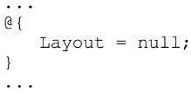
Razor
Visual Studio opens the Index.cshtml file for editing.
You’ll see that this file contains mostly HTML.
The exception is the part that looks like this:
This is an expression that will be interpreted by the Razor view engine, which processes the contents of views and generates HTML that is sent to the browser.
This is a simple Razor expression and it tells Razor that I chose not to use a layout, which is like a template for the HTML that will be sent to the browser (and which I describe in Chapter 5).
I am going to ignore Razor for the moment and come back to it later.
Make the addition to the Index.cshtml file that is shown in bold in Listing 2-5.
The addition displays another simple message.
Select Start Debugging from the Debug menu to run the application and test the view.

Slide 69
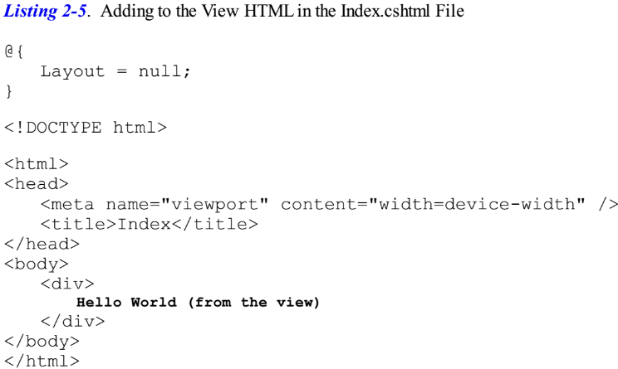
Listing 2-5

Slide 70
Action Results
When I first edited the Index action method, it returned a string value.
This meant that MVC did nothing except pass the string value as is to the browser.
Now that the Index method returns a ViewResult, the MVC Framework renders a view and returns the HTML it produces.
I didn’t tell MVC which view should be used, so it used the naming convention to find one automatically.
The convention is that the view has the name of the action method and is contained in a folder named after the controller:
/Views/Home/Index.cshtml
I can return other results from action methods besides strings and ViewResult objects.
For example, if I return a RedirectResult, the browser will be redirected to another URL.
If I return an HttpUnauthorizedResult, I force the user to log in.
These objects are collectively known as action results, and they are all derived from the ActionResult class.
The action result system lets us encapsulate and reuse common responses in actions.
I’ll tell you more about them and show more complex uses in Chapter 17.

Slide 71
Adding Dynamic Output
The whole point of a web application platform is to construct and display dynamic output.
In MVC, it is the controller’s job to construct some data and pass it to the view, which is responsible for rendering it to HTML.
One way to pass data from the controller to the view is by using the ViewBag object, which is a member of the Controller base class.
ViewBag is a dynamic object to which you can assign arbitrary properties, making those values available in whatever view is subsequently rendered.
Listing 2-6 demonstrates passing some simple dynamic data in this way in the HomeController.cs file.
I provide data for the view when I assign a value to the ViewBag.Greeting property.
The Greeting property didn’t exist until the moment I assigned the value—this allows me to pass data from the controller to the view in a free and fluid manner, without having to define classes ahead of time.
I refer to the ViewBag.Greeting property again in the view to get the data value, as illustrated in Listing 2-7, which shows the corresponding change to the Index.cshtml file.

Slide 72
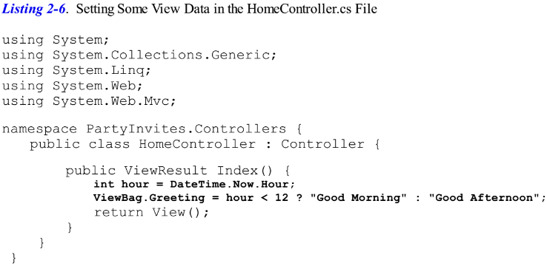
Listing 2-6

Slide 73
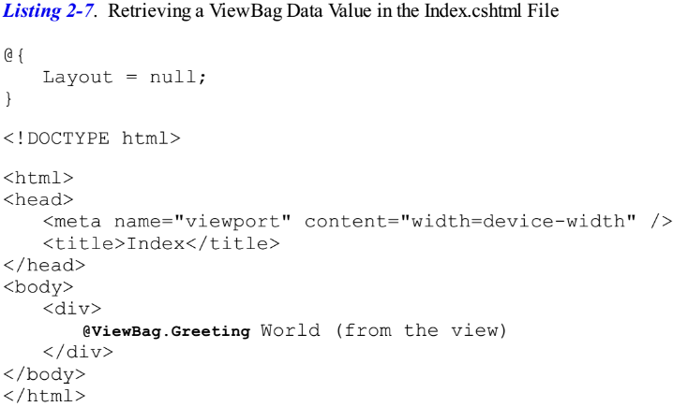
Listing 2-7

Slide 74
Razor Expression
The addition to Listing 2-7 is a Razor expression.
When I call the View method in the controller’s Index method, the MVC framework locates the Index.cshtml view file and asks the Razor view engine to parse the file’s content.
Razor looks for expressions like the one I added in the listing and processes them.
In this example, processing the expression means inserting the value assigned to the ViewBag.Greeting property in the action method into the view.
There’s nothing special about the property name Greeting; you could replace this with any property name and it would work the same, just as long as the name you use in the controller matches the name you use in the view.
You can pass multiple data values from your controller to the view by assigning values to more than one property.
You can see the effect of these changes by starting the project.

Slide 75
Creating a Simple Data-Entry Application
In the rest of this chapter, I will explore more of the basic MVC features by building a simple data-entry application.
I am going to pick up the pace in this section.
My goal is to demonstrate MVC in action, so I will skip over some of the explanations as to how things work behind the scenes.
But don’t worry, I’ll revisit these topics in depth in later chapters.

Slide 76
Setting the Scene
Imagine that a friend has decided to host a New Year’s Eve party and that she has asked me to create a web app that allows her invitees to electronically RSVP.
She has asked for four key features:
A home page that shows information about the party
A form that can be used to RSVP
Validation for the RSVP form, which will display a thank-you page
RSVPs e-mailed to the party host when complete
In the following sections, I will build up the MVC project I created at the start of the chapter and add these features.
I can check the first item off the list by applying what I covered earlier and add some HTML to my existing view to give details of the party.
Listing 2-8 shows the additions I made to the Views/Home/Index.cshtml file.
I am on my way. If you run the application, you’ll see the details of the party—well, the placeholder for the details, but you get the idea.

Slide 77
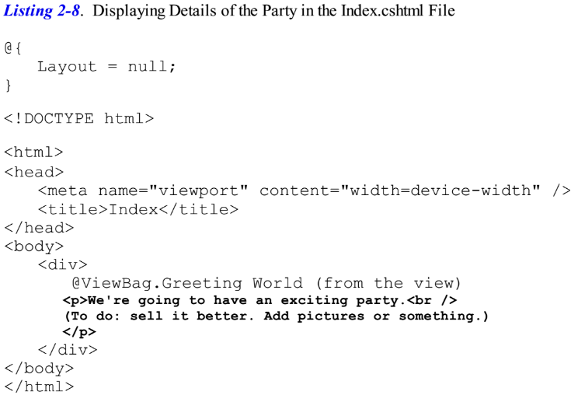
Listing 2-8

Slide 81
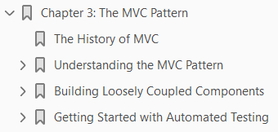
3
The MVC Pattern

Slide 82
Intro
Before I start digging into the details of the ASP.NET MVC Framework, I want to make sure you are familiar with the MVC design pattern and the thinking behind it.
In this chapter, I describe the following:
The MVC architecture pattern
Domain models and repositories
Creating loosely coupled systems using dependency injection (DI)
The basics of automated testing
You might be familiar with some of the ideas and conventions I discuss in this chapter, especially if you have done advanced ASP.NET or C# development.
If not, I encourage you to read carefully—a good understanding of what lies behind MVC can help put the features of the framework into context as you continue through the book.

Slide 83
The History of MVC
The term model-view-controller has been in use since the late 1970s and arose from the Smalltalk project at Xerox PARC, where it was conceived as a way to organize some early GUI applications.
Some of the fine detail of the original MVC pattern was tied to Smalltalk-specific concepts, such as screens and tools, but the broader concepts are still applicable to applications—and they are especially well suited to Web applications.
Interactions with an MVC application follow a natural cycle of user actions and view updates, where the view is assumed to be stateless.
This fits nicely with the HTTP requests and responses that underpin a Web application.
Further, MVC forces a separation of concerns—the domain model and controller logic are decoupled from the user interface.
In a Web application, this means that the HTML is kept apart from the rest of the application, which makes maintenance and testing simpler and easier.
It was Ruby on Rails that led to renewed mainstream interest in MVC and it remains the implementation template for the MVC pattern.
Many other MVC frameworks have since emerged and demonstrated the benefits of MVC—including, of course, ASP.NET MVC.

Slide 84
Understanding the MVC Pattern
In high-level terms, the MVC pattern means that an MVC application will be split into at least three pieces: Models, which contain or represent the data that users work with. These can be simple view models, which just represent data being transferred between views and controllers; or they can be domain models, which contain the data in a business domain as well as the operations, transformations, and rules for manipulating that data. Views, which are used to render some part of the model as a user interface. Controllers, which process incoming requests, perform operations on the model, and select views to render to the user.
(Page 82).

Slide 85
Understanding the Domain Model
The most important part of an MVC application is the domain model. We create the model by identifying the real-world entities, operations, and rules that exist in the industry or activity that the application must support, known as the domain. We then create a software representation of the domain: the domain model. For the purposes of the ASP.NET MVC Framework, the domain model is a set of C# types (classes, structs, etc.), collectively known as the domain types. The operations from the domain are represented by the
(Page 82).

Slide 86
The ASP.NET Implementation of MVC
In MVC, controllers are C# classes, usually derived from the System.Web.Mvc.Controller class. Each public method in a class derived from Controller is an action method, which is associated with a configurable URLthrough the ASP.NET routing system. When a request is sent to the URLassociated with an action method, the statements in the controller class are executed in order to perform some operation on the domain model and then select a view to display to the client. Figure 3-1 shows the interactions between the controller, model, and view.
(Page 83).

Slide 87
Comparing MVC to Other Patterns
MVC is not the only software architecture pattern, of course. There are many others and some of them are, or at least have been, extremely popular. We can learn a lot about MVC by looking at the alternatives. In the following sections, I briefly describe different approaches to structuring an application and contrast them with MVC. Some of the patterns are close variations on the MVC theme, whereas others are entirely different. I am not suggesting that MVC is the perfect pattern for all situations. I am a proponent of picking the best approach to solve the problem at hand. As you will see, there are situations where some competing patterns are as useful as or better than MVC. I encourage you to make an informed and deliberate choice when selecting a pattern. The fact that you are reading this book suggests that you already have a certain commitment to the MVC pattern, but it is always helpful to maintain the widest possible perspective.
(Page 84).

Slide 88
Understanding the Smart UI Pattern
One of the most common design patterns is known as the smart user interface (smart UI). Most programmers have created a smart UI application at some point in their careers—I certainly have. If you have used Windows Forms or ASP.NET Web Forms, you have too. To build a smart UI application, developers construct a user interface, often by dragging a set of components or controls onto a design surface or canvas. The controls report interactions with the user by emitting events for button presses, keystrokes, mouse movements, and so on. The developer adds code to respond to these events in a series of event handlers: small blocks of code that are called when a specific event on a specific component is emitted. This creates a monolithic application, as shown in Figure 3-2. The code that handles the user interface and the business is all mixed together with no separation of concerns at all. The code that defines the acceptable values for a data input, that queries for data or modifies a user account, ends up in little pieces, coupled together by the order in which events are expected.
(Page 84).

Slide 89
Understanding the Model-View Architecture
The area in which maintenance problems tend to arise in a Smart UI application is in the business logic, which ends up so diffused across the application that making changes or adding features becomes a fraught process. An improvement in this area is offered by the model-view architecture, which pulls out the business logic into a separate domain model. In doing this, the data, processes,
(Page 85).

Slide 90
Understanding Classic Three-Tier Architectures
To address the problems of the model-view architecture, the three-tier or three-layer pattern separates the persistence code from the domain model and places it in a new component called the ddata access layer (DAL). This is shown in Figure 3-4.
(Page 86).

Slide 91
Understanding Variations on MVC
I have already described the core design principles of MVC applications, especially as they apply to the ASP.NET MVC implementation. Others interpret aspects of the pattern differently and have added to, adjusted, or otherwise adapted MVC to suit the scope and subject of their projects. In the following sections, I provide a brief overview of the two most prevalent variations on the MVC theme. Understanding these variations is not essential to working with ASP.NET MVC and I have included this information just for completeness because you will hear the terms used in most discussions of software patterns.
(Page 87).

Slide 92
Understanding the Model-View-Presenter Pattern
Model-view-presenter (MVP) is a variation on MVC that is designed to fit more easily with stateful GUI platforms such as Windows Forms or ASP.NET Web Forms. This is a worthwhile attempt to get the best aspects of the Smart UI pattern without the problems it usually brings. In this pattern, the presenter has the same responsibilities as an MVC controller, but it also takes a more direct relationship to a stateful view, directly managing the values displayed in the UI components according to the user’s inputs and actions. There are two implementations of this pattern: The passive view implementation, in which the view contains no logic—it is a container for UI controls that are directly manipulated by the presenter. The supervising controller implementation, in which the view may be responsible for some elements of presentation logic, such as data binding, and has been given a reference to a data source from the domain models. The difference between these two approaches relates to how intelligent the view is. Either way, the presenter is decoupled from the GUI framework, which makes the presenter logic simpler and suitable for unit testing.
(Page 87).

Slide 93
Understanding the Model-View-View Model Pattern
The model-view-view model (MVVM) pattern is the most recent variation on MVC. It originated from Microsoft and is used in the Windows Presentation Foundation (WPF). In the MVVM pattern, models and views have the same roles as they do in MVC. The difference is the MVVM concept of a view model, which is an abstract representation of a user interface—typically a C# class that exposes both properties for the data to be displayed in the UI and operations on the data that can be invoked from the UI. Unlike an MVC controller, an MVVM view model has no notion that a view (or any specific UI technology) exists. An MVVM view uses the WPF binding feature to bi-directionally associate properties exposed by controls in the view (items in a drop-down menu, or the effect of pressing a
(Page 87).

Slide 94
Building Loosely Coupled Components
One of most important features of the MVC pattern is that it enables separation of concerns. I want the components in my applications to be as independent as possible and to have as few interdependencies as I can arrange. In an ideal situation, each component knows nothing about any other component and only deals with other areas of the application through abstract interfaces. This is known as loose coupling, and it makes testing and modifying applications easier. A simple example will help put things in context. If I am writing a component called MyEmailSender that will send e-mails, I would implement an interface that defines all of the public functions required to send an e-mail, which I would call IEmailSender. Any other component of my application that needs to send an e-mail—let’s say a password reset helper called PasswordResetHelper—can then send an e-mail by referring only to the methods in the interface. There is no direct dependency between PasswordResetHelper and MyEmailSender, as shown by Figure 3-5.
(Page 88).

Slide 95
Using Dependency Injection
Interfaces help decouple components, but I still face a problem: C# doesn’t provide a built-in way to easily create objects that implement interfaces, except to create an instance of the concrete component with the new keyword. I end up with code like this:
(Page 88).

Slide 96
Breaking and Declaring Dependencies
There are two parts to the DI pattern. The first is that I remove any dependencies on concrete classes from my component—in this case PasswordResetHelper. I do this by creating a class constructor that accepts implementations of the interfaces I need as arguments, like this:
(Page 89).

Slide 97
Injecting Dependencies
The second part of the DI pattern is to inject the dependencies declared by the PasswordResetHelper class when I create instances of it, hence the term dependency injection. All this really means is that I need to decide which class that implements the IEmailSender interface I am going to use, create an object from that class and then pass the object as an argument to the PasswordResetHelper constructor.
(Page 90).

Slide 98
Using a Dependency Injection Container
I have resolved my dependency issue, but how do I instantiate the concrete implementation of interfaces without creating dependencies somewhere else in the application? As it stands, I still have
(Page 90).

Slide 99
Getting Started with Automated Testing
The ASP.NET MVC Framework is designed to make it as easy as possible to set up automated tests and use development methodologies such as test-driven development (TDD), which I explain later in this chapter. ASP.NET MVC provides an ideal platform for automated testing and Visual Studio has some solid testing features. Between them they make designing and running tests simple and easy. In broad terms, Web application developers today focus on two kinds of automated testing. The first is unit testing, which is a way to specify and verify the behavior of individual classes (or other small units of code) in isolation from the rest of the application. The second type is integration testing, which is a way to specify and verify the behavior of multiple components working together, up to and including the entire Web application. Both kinds of testing can be valuable in Web applications. Unit tests, which are simple to create and run, are brilliantly precise when you are working on algorithms, business logic, or other back-end infrastructure. The value of integration testing is that it can model how a user will interact with the UI, and can cover the entire technology stack that your application uses, including the Web server and database. Integration testing tends to be better at detecting new bugs that have arisen in old features; this is known as regression testing.
(Page 92).

Slide 100
Understanding Unit Testing
In the .NET world, you create a separate test project in your Visual Studio solution to hold test fixtures . This project will be created when you first add a unit test, or can be set up automatically when you use an MVC project template. A test fixture is a C# class that defines a set of test methods: one method for each behavior you want to verify. A test project can contain multiple test fixture classes.
(Page 93).

Slide 101
Using TDD and the Red-Green-Refactor Workflow
With test-driven development (TDD), you use unit tests to help design your code. This can be an odd concept if you are used to testing after you have finished coding, but there is a lot of sense in this approach. The key concept is a development workflow called red-green-refactor. It works like this: Determine that you need to add a new feature or method to your application. Write the test that will validate the behavior of the new feature when it is written. Run the test and get a red light Write the code that implements the new feature. Run the test again and correct the code until you get a green light.
(Page 97).

Slide 102
Understanding Integration Testing
For Web applications, the most common approach to integration testing is UI automation, which means simulating or automating a Web browser to exercise the application’s entire technology stack by reproducing the actions that a user would perform, such as pressing buttons, following links, and submitting forms. The two best-known open source browser automation options for .NET developers are Selenium RC (http://seleniumhq.org/), which consists of a Java “server” application that can send automation commands to Internet Explorer, Firefox, Safari, or Opera, plus clients for .NET, Python, Ruby, and multiple others so that you can write test scripts in the language of your choice. Selenium is powerful and mature; its only drawback is that you have to run its Java server. WatiN (http://watin.org), a .NET library that can send automation
(Page 98).

Slide 103
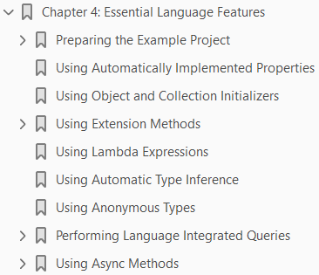
4
Essential Language Features

Slide 104
Intro
C# is a feature-rich language and not all programmers are familiar with all of the features I rely on in this book. In this chapter, I describe the C# language features that a good MVC programmer needs to know and that I use in examples throughout this book. I provide only a short summary of each feature. If you want more in-depth coverage of C# or LINQ, three of my books may be of interest. For a complete guide to C#, try Introducing Visual C#; for in-depth coverage of LINQ, check out Pro LINQ in C#; and for a detailed examination of the .NET support for asynchronous programming see Pro .Net Parallel Programming in C#. All of these books are published by Apress. Table 4-1 provides the summary for this chapter.
(Page 100).

Slide 105
Preparing the Example Project
To demonstrate the language features in this part of the book, I have created a new Visual Studio project called LanguageFeatures using the ASP.NET MVC Web Application template. I selected the Empty option for the initial content and checked the option for MVC folders and references, just as I did in Chapter 2. The language features that I describe in this chapter are not specific to MVC, but Visual Studio Express 2013 for Web doesn’t support creating projects that can write to the console, so you will have to create an MVC app if you want to follow along with the
(Page 100).

Slide 106
Adding the System.Net.Http Assembly
Later in the chapter, I’ll be using an example that relies on the System.Net.Http assembly, which isn’t added to MVC projects by default. Select Add Reference from the Visual Studio Project menu to open the Reference Manager window. Ensure that the Assemblies section is selected on the left-hand side and locate and check the System.Net.Http item, as shown in Figure 4-1.
(Page 102).

Slide 107
Using Automatically Implemented Properties
The regular C# property feature lets you expose a piece of data from a class in a way that decouples the data from how it is set and retrieved. Listing 4-3 contains a simple example in a class called
(Page 102).

Slide 108
Using Object and Collection Initializers
Another tiresome programming task is constructing a new object and then assigning values to the properties, as illustrated by Listing 4-8, which shows the addition of a CreateProduct action method to the Home controller.
(Page 106).

Slide 109
Using Extension Methods
Extension methods are a convenient way of adding methods to classes that you do not own and cannot modify directly. Listing 4-11 shows a ShoppingCart class, which I added to the Models folder in a file called ShoppingCart.cs file and which represents a collection of Product objects.
(Page 108).

Slide 110
Applying Extension Methods to an Interface
I can also create extension methods that apply to an interface, which allows me to call the extension method on all of the classes that implement the interface. Listing 4-14 shows the ShoppingCart class updated to implement the IEnumerable<Product> interface.
(Page 110).

Slide 111
Creating Filtering Extension Methods
The last thing I want to show you about extension methods is that they can be used to filter collections of objects. An extension method that operates on an IEnumerable<T> and that also returns an IEnumerable<T> can use the yield keyword to apply selection criteria to items in the source data to produce a reduced set of results. Listing 4-17 demonstrates such a method, which I have added to the MyExtensionMethods class.
(Page 113).

Slide 112
Using Lambda Expressions
I can use a delegate to make my FilterByCategory method more general. That way, the delegate that will be invoked against each Product can filter the objects in any way I choose, as illustrated by Listing 4-19, which shows the Filter extension method I added to the MyExtensionMethods class.
(Page 115).

Slide 113
Using Automatic Type Inference
The C# var keyword allows you to define a local variable without explicitly specifying the variable type, as demonstrated by Listing 4-24. This is called type inference, or implicit typing.
(Page 120).

Slide 114
Using Anonymous Types
By combining object initializers and type inference, I can create simple data-storage objects without needing to define the corresponding class or struct. Listing 4-25 shows an example.
(Page 120).

Slide 115
Performing Language Integrated Queries
All of the features I have described so far are put to good use in LINQ. I love LINQ. It is a wonderful
(Page 121).

Slide 116
Understanding Deferred LINQ Queries
You will notice that Table 2 includes a Deferred column. There is an interesting variation in the way that the extension methods are executed in a LINQ query. A query that contains only deferred methods is not executed until the items in the result are enumerated, as demonstrated by Listing 4-30, which shows a simple change to the FindProducts action method.
(Page 126).

Slide 117
Using Async Methods
One of the big recent additions to C# is improvements in the way that asynchronous methods are dealt with. Asynchronous methods go off and do work in the background and notify you when they are complete, allowing your code to take care of other business while the background work is performed. Asynchronous methods are an important tool in removing bottlenecks from code and allow applications to take advantage of multiple processors and processor cores to perform work in parallel. C# and .NET have excellent support for asynchronous methods, but the code tends to be verbose and developers who are not used to parallel programming often get bogged down by the unusual syntax. As an example, Listing 4-32 shows an asynchronous method called GetPageLength, which I defined in a class called MyAsyncMethods and added to the Models folder in a class file called MyAsyncMethods.cs.
(Page 128).

Slide 118
Applying the async and await Keywords
Microsoft introduced two keywords to C# that are specifically intended to simplify using asynchronous methods like HttpClient.getAsync. The keywords are async and await and you can see how I have used them to simplify my example method in Listing 4-33.
(Page 130).

Slide 119
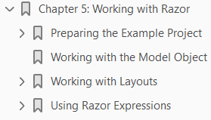
5
Working with Razor

Slide 120
Intro
A view engine processes ASP.NET content and looks for instructions, typically to insert dynamic content into the output sent to a browser and Razor is the name of the MVC Framework view engine.
There are no changes to Razor in MVC 5 and if you are already familiar with the syntax from earlier versions you can skip ahead.
In this chapter, I give you a quick tour of the Razor syntax so you can recognize Razor expressions when you see them.
I am not going to supply an exhaustive Razor reference in this chapter; think of this more as a crash course in the syntax.
I explore Razor in depth as I continue through the book, within the context of other MVC Framework features.
Table 5-1 provides the summary for this chapter.

Slide 121
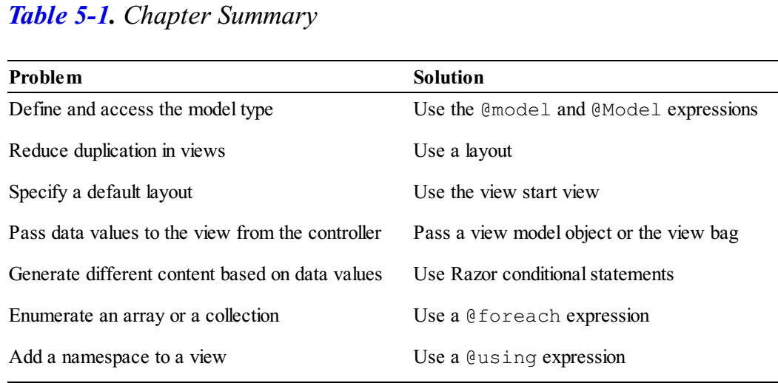
Table 5-1

Slide 122
Preparing the Example Project
To demonstrate Razor, I created a new Visual Studio project called Razor using the ASP.NET MVC Web Application template.
I selected the Empty option and checked the box to get the initial configuration for an MVC project.

Slide 123
Defining the Model
I am going to start with a simple domain model called Product, defined in a class file called Product.cs, which I added to the Models folder.
You can see the contents of the new file in Listing 5-1.

Slide 124
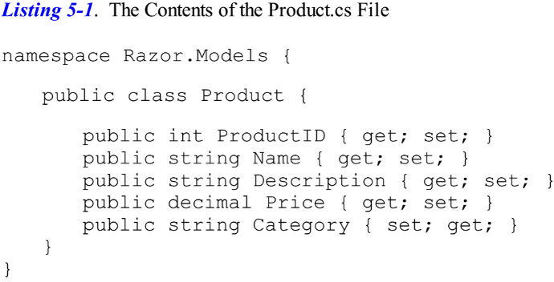
Listing 5-1

Slide 125
Defining the Controller
I am going to follow the MVC Framework convention and define a controller called Home as the initial starting point for my project.
Right-click the Controllers folder in the Solution Explorer, select Add Controller, select MVC 5 Controller–Empty, click Add and set the name to HomeController.
When you click the second Add button, Visual Studio will create the Controllers/HomeController.cs file.
Edit the contents to match those shown in Listing 5- 2.
The controller defines an action method called Index, in which I create and populate the properties of a Product object.
I pass the Product to the View method so that it is used as the model when the view is rendered.
I do not specify the name of a view file when I call the View method, so the default view for the action method will be used.

Slide 126
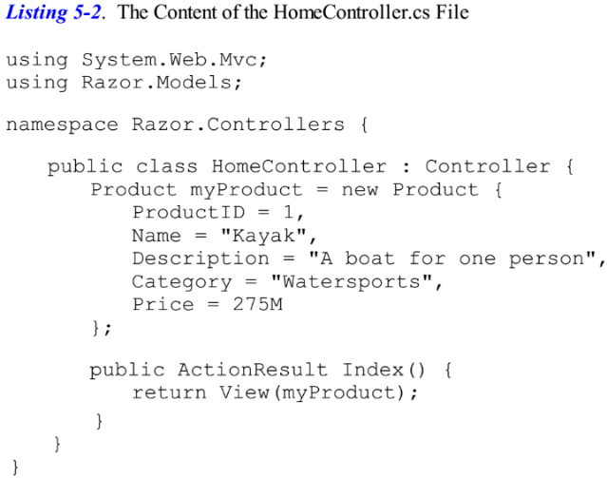
Listing 5-2

Slide 127
Creating the View
Right-click on the Index method in the HomeController class and select Add View from the pop-up menu.
Ensure that the name of the view is Index, change the Template to Empty and select Product for the model class. (If you don’t see Product as an option for the model, compile the project and start over).
Uncheck the View Option boxes and click Add to create the Index.cshtml file in the Views/Home folder.
The initial contents of the new view are shown in Listing 5-3.
In the sections that follow, I go through the different parts of a Razor view and demonstrate some of the different things you can do with one.
When learning about Razor, it is helpful to bear in mind that views exist to express one or more parts of the model to the user—and that means generating HTML that displays data that is retrieved from one or more objects.
If you remember that I am always trying to build an HTML page that can be sent to the client, then everything that Razor does begins to make sense.

Slide 128
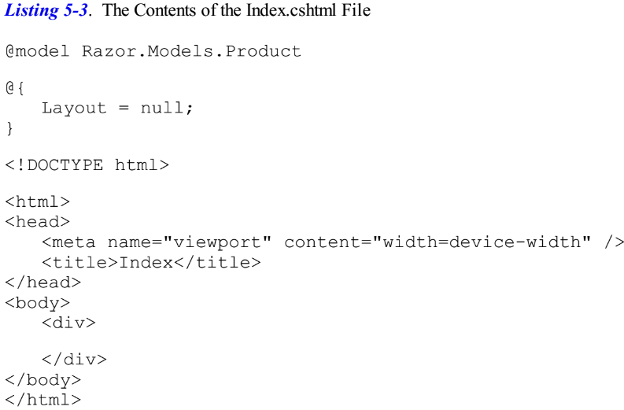
Listing 5-3
\

Slide 129
Working with the Model Object

Slide 130
Working with Layouts

Slide 131
Creating the Layout

Slide 132
Applying a Layout

Slide 133
Using a View Start File

Slide 134
Demonstrating Shared Layouts

Slide 135
Using Razor Expressions
Now that I have shown you the basics of views and layouts, I am going to turn to the different kinds of expressions that Razor supports and how you can use them to create view content.
In a good MVC Framework application, there is a clear separation between the roles that the action method and view perform.
The rules are simple and I have summarized them in Table 5-2.
I am going to come back to this theme throughout this book.
To get the best from the MVC Framework, you need to respect and enforce the separation between the different parts of the app.
As you will see, you can do quite a lot with Razor, including using C# statements—but you should not use Razor to perform business logic or manipulate your domain model objects in any way.
Equally, you should not format the data that your action method passed to the view.
Instead, let the view figure out data it needs to display.
You can see a simple example of this in the previous section of this chapter.
I defined an action method called NameAndPrice, which displays the value of the Name and Price properties of a Product object.

Slide 136
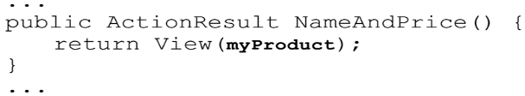
Using Razor Expressions |
Even though I knew which properties I needed to display, I passed the complete Product object to the view model, like this:
I then used the Razor @Model expression in the view to get the value of the properties I was interested in, like this:
I could have created the string I wanted to display in the action method and passed it as the view model object to the view.
It would have worked, but taking this approach undermines the benefit of the MVC pattern and reduces my ability to respond to changes in the future.
As I said, I will return to this theme again, but you should remember that the MVC Framework does not enforce proper use of the MVC pattern and that you must remain aware of the effect of the design and coding decisions you make.

Slide 137
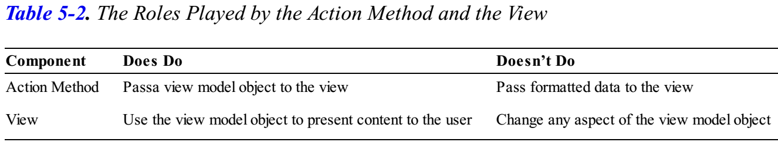
Table 5-2

Slide 138
PROCESSING VERSUS FORMATTING DATA
It is important to differentiate between processing data and formatting it.
Views format data, which is why I passed the Product object in the previous section to the view, rather than formatting the object's properties into a display string.
Processing data–including selecting the data objects to display–is the responsibility of the controller, which will call on the model to get and modify the data it requires.
It can sometimes be hard to figure out where the line between processing and formatting is, but as a rule of thumb, I recommend erring on the side of caution and pushing anything but the most simple of expressions out of the view and into the controller.

Slide 139
Inserting Data Values
The simplest thing you can do with a Razor expression is to insert a data value into the markup.
You can do this using the @Model expression to refer to properties and methods defined by the view model object or use the @ViewBag expression to refer to properties you have defined dynamically using the view bag feature (which I introduced in Chapter 2).
You have already seen examples of both these expressions, but for completeness, I have added a new action method to the Home controller called DemoExpressions that passes data to the view using a model object and the view bag. You can see the definition of the new action method in Listing 5-13.

Slide 140
Setting Attribute Values

Slide 141
Using Conditional Statements

Slide 142
Enumerating Arrays and Collections

Slide 143
Dealing with Namespaces

Slide 144
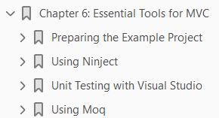
6
Essential Tools for MVC

Slide 145
Intro
In this chapter, I am going to look at three tools that should be part of every MVC programmer’s arsenal: a dependency injection (DI) container, a unit test framework, and a mocking tool. I have picked three specific implementations of these tools for this book, but there are many alternatives for each type of tool. If you cannot get along with the ones I use, do not worry. There are so many out there, that you are certain to find something that suits the way your mind and workflow operate. As I noted in Chapter 3, Ninject is my preferred DI container. It is simple, elegant, and easy to use. There are more sophisticated alternatives, but I like the way that Ninject works with a minimum of configuration. If you do not like Ninject, I recommend trying Unity, which is an alternative from Microsoft. For unit testing, I am going to be using the built-in Visual Studio testing tools. I used to use NUnit, which is a popular .NET unit-testing framework, but Microsoft has made a big push to improve the unit-testing support in Visual Studio and now includes it in the free Visual Studio editions. The result is a unit test framework that is tightly integrated into the rest of the IDE and which has actually become pretty good. The third tool I selected is Moq, which is a mocking tool kit. I use Moq to create implementations of interfaces to use in unit tests. Programmers either love or hate Moq; there is nothing in the middle. Either you will find the syntax elegant and expressive, or you will be cursing every time you try to use it. If you just cannot get along with it, I suggest looking at Rhino Mocks, which is a nice alternative. I introduce each of these tools and demonstrate their core features, but I do not provide exhaustive coverage of these tools. Each could easily fill a book in its own right. I have given you enough to get started and, critically, to follow the examples in the rest of the book. Table 6-1 provides the summary for this chapter.
(Page 159).

Slide 146
Preparing the Example Project
I am going to start by creating a simple example project, called EssentialTools, which I will use throughout this chapter. I used the ASP.NET MVC Web Application template, selected the Empty option and checked the box to add the basic MVC project content.
(Page 160).

Slide 147
Using Ninject
I introduced dependency injection (DI) in Chapter 3. To recap, the idea is to decouple the components in an MVC application, with a combination of interfaces and DI container that creates instances of objects by creating implementations of the interfaces they depend on and injecting them into the constructor. In the sections that follow, I explain a problem I deliberately created in the example for this chapter and show how to use Ninject–my preferred DI container–to solve it. Do not worry if you find that you cannot get along with Ninject–the basic principles are the same for all DI containers and there are many alternatives from which to choose.
(Page 164).

Slide 148
Unit Testing with Visual Studio
In this book, I use the built-in unit test support that comes with Visual Studio, but there are other .NET unit-test packages available. The most popular is probably NUnit, but all of the test packages do much the same thing. The reason I have selected the Visual Studio test tools is that I like the integration with the rest of the IDE. To demonstrate the Visual Studio unit-test support, I added a new implementation of the IDiscountHelper interface to the example project. Create a new file in the Models folder called MinimumDiscountHelper.cs and ensure that the contents match those shown in Listing 6-26.
(Page 180).

Slide 149
Using Moq
One of the reasons that I am able to keep my tests so simple in the previous section was because I am testing a single class that depends on no other class to function. Such objects exist in real projects, of course, but you will also need to test objects that cannot function in isolation. In these situations, you need to be able to focus on the class or method you are interested in, so that you are not implicitly testing the dependencies as well. One useful approach is to use mock objects, which simulate the functionality of real objects from your project, but in a specific and controlled way. Mock objects let you narrow the focus of your tests so that you only examine the functionality in which you are interested. The paid-for versions of Visual Studio include support for creating mock objects through a feature
(Page 190).

Slide 150
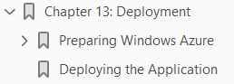
13
Deployment

Slide 151
Intro
The final, and critical, step in application development is deployment:
making your application available for the world to use.
In this chapter, I'll show you how to prepare and deploy the SportsStore application.
There are lots of different ways to deploy MVC Framework applications and a wide range of deployment targets.
You can deploy to a Windows Server machine running Internet Information Services (IIS) which you run and manage locally
you can deploy to a remote hosting service that manages servers for you or
increasingly, you can deploy to a cloud infrastructure platform that provisions and scales your application to seamlessly meet demand.
I thought long and hard about how to create a useful example deployment in this chapter.
I ruled out showing you how to deploy directly to IIS because the server configuration process is long and complicated, and most MVC Framework developers that are targeting local servers rely on an IT operations group to perform configuration and deployment tasks.
I also ruled out demonstrating deployment to a managed hosting company because each has its own custom deployment processes and no one company sets the standard for hosting.

Slide 152
Windows Azure
So, somewhat by default, I settled on demonstrating a deployment to Windows Azure, which is Microsoft’s cloud platform and which has some nice support for MVC applications.
I am not suggesting that Azure is suitable for all deployments, but I like the way it works and using it in this chapter allows me to demonstrate the deployment process rather than getting bogged down in IIS and Windows configuring issues.
There is a free 90-day trial available on Azure as I write this (and MSDN subscriptions include Azure), which means that you should be able to follow the example in this chapter, even if you don’t intend to use Azure to host your application.
Deploying a web application used to be a tedious and error-prone process, but Microsoft has put a lot of effort into improving the deployment tools in Visual Studio.
So even if you need to deploy to a different kind of infrastructure, you will find that Visual Studio is able to do a lot of the heavy lifting for you.

Slide 153
CAUTION
I recommend that you practice deployment using a test application and server before attempting to deploy a real application into a production environment.
Like every other aspect of the software development life cycle, the deployment process benefits from testing.
I have a stock of horror stories of project teams who have destroyed operational applications through overly hasty and poorly tested deployment procedures.
It is not that the ASP.NET deployment features are especially dangerous—they are not—but rather, any interaction that involves a running application with real user data deserves careful thought and planning.

Slide 154
Preparing Windows Azure
You have to create an account before you can use Azure, which you can do by going to www.windowsazure.com.
At the time of writing, Microsoft is offering free trial accounts, and MSDN packages include Azure services.
Once you have created your account, you can manage your Azure services by going to http://manage.windowsazure.com to provide your credentials.
When you start, you will see the summary view shown in Figure 13-1.
(Page 401).

Slide 155
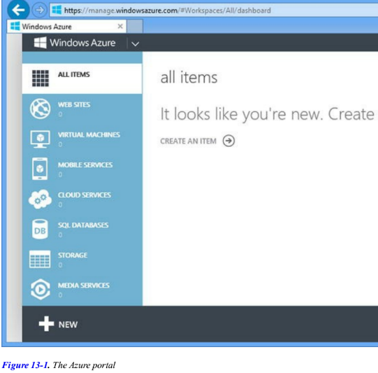
Figure 13-1

Slide 156
Creating the Web Site and Database
Creating the Web Site and Database I start by creating a new web site and database service, which are two of the cloud services offered by Azure.
Click the large plus sign in the bottom-left corner of the portal window and select Compute => Web Site => Custom Create.
You will see the form illustrated in Figure 13-2.
I need to select a URL for my application.
For the free Azure services, I am restricted to names in the azurewebsites.net domain.
I have chosen the name mvc5sportsstore, but you will have to choose your own name since each Azure web site requires a unique name.
Select the region that you want your application deployed to and ensure that the Create a new SQL database option is selected for the Database field. (Azure can use MySql, which the SportsStore application is not set up to use, so I want the option that gives me a SQL Server database.)
Set the DB Connection String Name field to EFDbContext.
This is the name the SportsStore application uses to get a database connection from the Web.config file, and by using this name in the Azure service, I ensure that the application code works in deployment without modification.

Slide 157
Creating the Web Site and Database |
When you have filled out the form, click the arrow button to proceed to the form shown in Figure 13-3.
Set a name for the database.
I have used mvc5sportsstore_db so that it is obvious which application the database relates to.
Select the New SQL Data Server option for the Server field and enter a login name and password.
I specified a name of sportsstore and followed the guidance provided by the form to select a password containing mixed-case letters and numbers.
Make a note of the username and password you use because you will need them in the next section.
Click the check mark button to complete the setup process.
Azure will create new web site and database services, which can take a few minutes.
You will be returned to the overview when setup is complete and you will see that the Web Sites and SQL Databases categories each report one item, as shown in Figure 13-4.

Slide 158
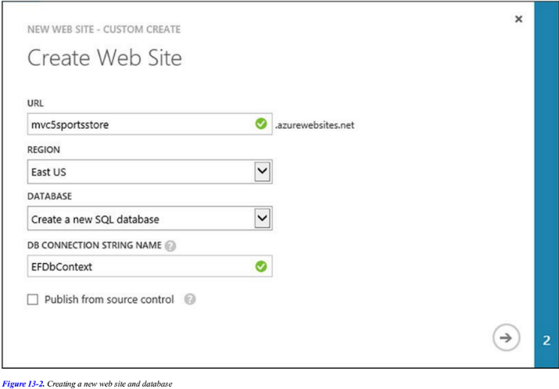
Figure 13-2

Slide 159
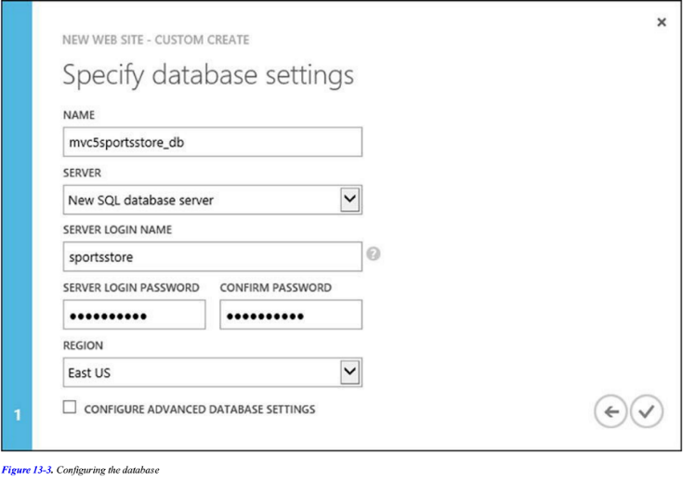
Figure 13-3

Slide 160
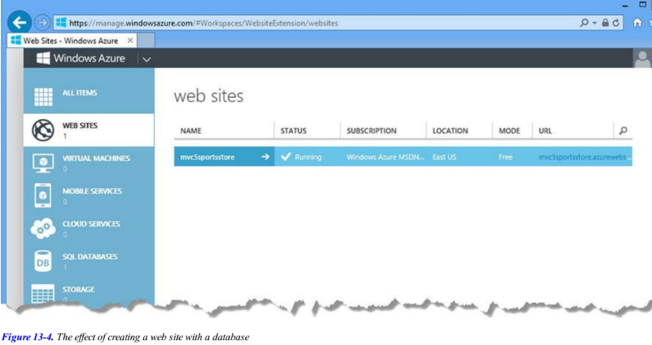
Figure 13-4

Slide 161
Preparing Database for Remote Administration
The next step is to configure the Azure database so that it contains the same schema and data that I used in Chapter 7.
Click the SQL Databases link in the Azure summary page and then click the entry that appears in the SQL Databases table. (If you are following my example, the database will be called mvc5sportsstore_db.)
The portal will show you details of the database and various options for configuring and managing it.
Click the Set up Windows Azure firewall rules for this address link, which you will find in the Design Your Database section of the page. You will see a message that tells you that your current IP address (which is to say the IP address of your workstation) is not in the firewall rules.
Click the Yes button as shown in Figure 13-5.

Slide 162
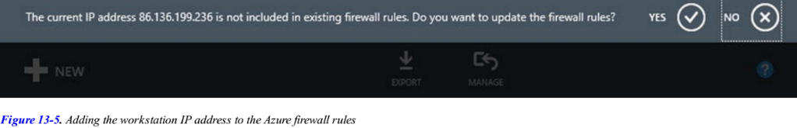
Figure 13-5

Slide 163
CAUTION
Visual Studio has support for deploying the database along with the application.
I recommend against using this feature since it is trivially easy to wipe out your real application data with a careless menu selection.
Always update your database separately and test thoroughly before doing so.

Slide 164
Creating the Schema
The next step is to create the schema for the database.
Click the Design your SQL database link in the Connect to your Database section.
Enter the database name (mvc5sportsstore_db), username (sportsstore), and the password that you defined when creating the database, and click the Log On button, as shown in Figure 13-6.
At the top of the window you will see a New Query button.
Click the button and a text area will enter into which you can type SQL commands.
This is where I am going to provide the SQL commands that will create the database table I need.

Slide 165
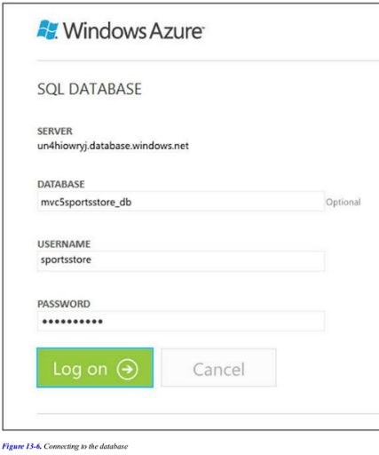
Figure 13-6

Slide 166
Tip
Managing the database requires Silverlight, which you may need to install in your browser before you can continue.

Slide 167
Getting the Schema Command
I can get the SQL statements I need from Visual Studio.
Open the Server Explorer window and expand the items it contains until you reach the entry for the Products table in the development SportsStore application.
Right-click the Products table and select Open Table Definition.
The editor for the table schema will be opened.
In the T-SQL tab, you will see the SQL shown in Listing 13-1.
Copy the SQL from Visual Studio, paste it into the text area in the browser, and click the Run button at the top of the browser window.
After a second, you will see the message Command(s) completed successfully, which indicates that the Azure database contains a Product database using the same schema as I defined in the SportsStore application.

Slide 168
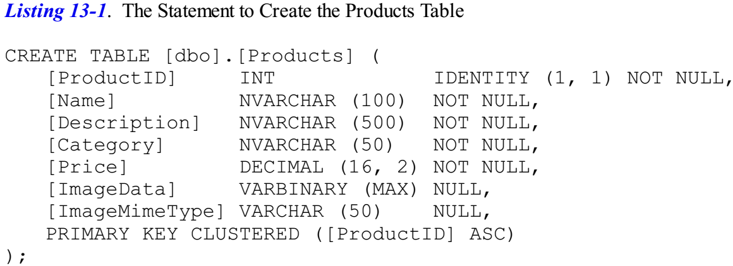
Listing 13-1

Slide 169
Adding the Table Data
Now that I have created the table, I can populate it with the product data that I used in Chapter 7.
Return to the Products entry in the Database Explorer window, right-click, and select Show Table Data from the pop-up menu.
You will find a Script button at the top of the window that is opened, as shown in Figure 13-7.
A new window will open containing another SQL statement.
Clear the text area in the Azure browser window and paste the SQL in its place.
Click the Run button. The script will be executed and add the data to the table.

Slide 170
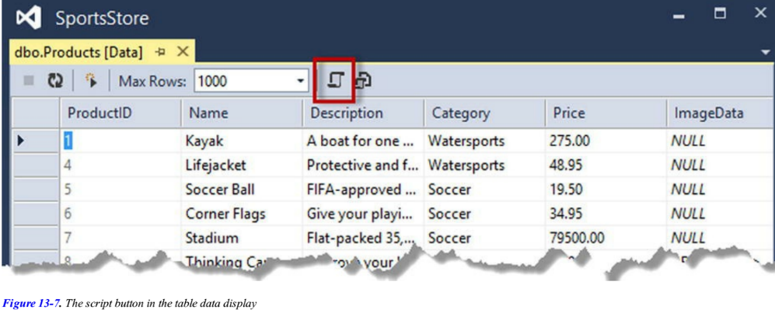
Figure 13-7

Slide 171
Deploying the Application
Now that the setup is complete, deploying the application is simple.
Return to the main Azure portal and click the Web Sites button.
Click the mvc5sportsstore web site to open the dashboard page and click the Download the publish profile link in the Publish your app section.
Save this file in a prominent location.
For my Azure service, the file is called mvc5sportsstore.azurewebsites.net.PublishSettings and I saved it to the desktop.
This file contains the details that Visual Studio needs to publish your app to the Azure infrastructure.
Return to Visual Studio and right-click the SportsStore.WebUI project in the Solution Explorer and select Publish from the pop-up menu.
You will see the Publish Web dialog window, as illustrated by Figure 13-8.
Click the Import button and locate the file that you downloaded from the Azure portal.
Visual Studio will process the file and display the details of your Azure service configuration, as shown in Figure 13-9.
Your details will reflect the name you selected for your web site.

Slide 172
Deploying the Application |
There is no need to change any of the values that are displayed.
Click the Next button to move to the next stage of the deployment process, which you can see in Figure 13-10.

Slide 173
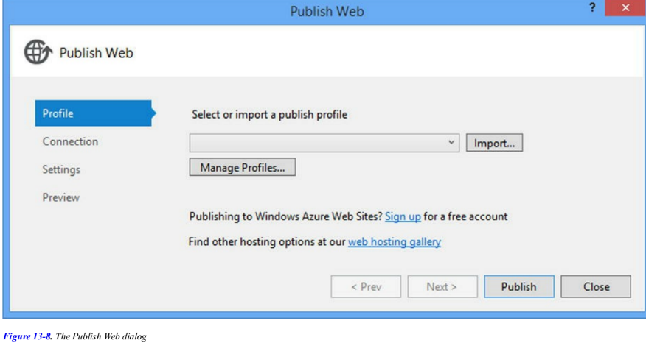
Figure 13-8

Slide 174
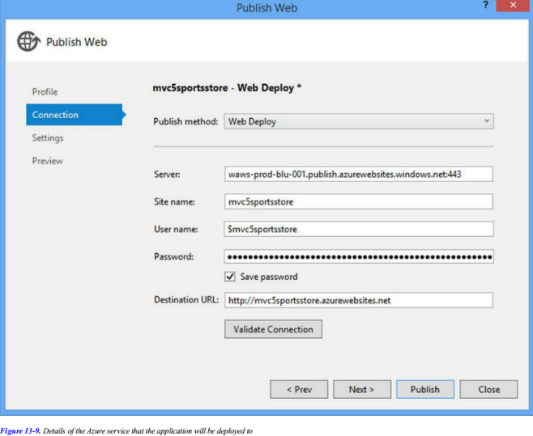
Figure 13-9

Slide 175
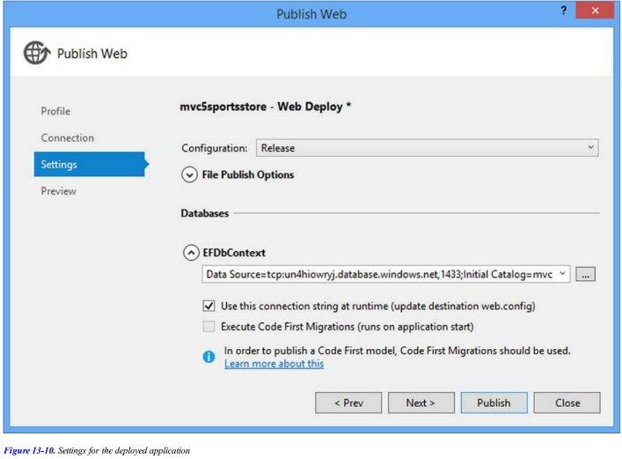
Figure 13-10

Slide 176
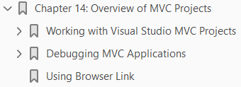
14
Overview of MVC Project

Slide 177
Intro
I am going to provide some additional context before diving into MVC Framework features.
This chapter gives an overview of
the structure and nature of an ASP.NET MVC application
including the default project structure and naming conventions,
some of which are optional and some of which are hard-coded into the way that the MVC Framework operates

Slide 178
Working with Visual Studio MVC Projects
When you create a new ASP.NET project, Visual Studio gives you a number of choices as to the initial content you want in the project.
The idea is to ease the learning process for new developers and apply some time-saving best practices for common features and tasks.
This support continues with templates used to create controllers and views that are created with template code for listing data objects, editing model properties and so on.
With Visual Studio 2013 and MVC 5, Microsoft has updated the templates and scaffolding, as it is known, to blur the boundaries between different kinds of ASP.NET project and to provide a wider range of project templates and code configurations.
Part 1 of this book will have left you in no doubt that I am not a fan of this kind of approach to cookie cutter project or code.
The intent is good, but the execution is always underwhelming.

Slide 179
MVC Framework Flexibility
One of the characteristics I like most about ASP.NET and the MVC Framework is just how much flexibility I have in tailoring the platform to suit my development style, and the projects, classes and views that Visual Studio creates and populates make me feel constrained to work in someone else’s style.
I also find the content and configuration too generic and too bland to be useful.
In Chapter 10, I mentioned that one of the dangers of using responsive design to target mobile devices is a kind of averaging that ends up compromising the experience for all devices, and something similar has happened to the Visual Studio templates.
Microsoft can’t possibly know what kind of application you need to create and so they cover all the bases, but in such a drab and generalized way that I end up just ripping out the default content anyway.
My advice (given to anyone who makes the mistake of asking) is to start with an empty project and add the folders, files, and packages that you need.
Not only will you learn more about the way that the MVC Framework works, but you will have complete control over what your application contains.
But my preferences should not color your development experience. You may find the templates and scaffolding more useful than I do, especially if you are new to ASP.NET development and you have not yet developed a distinctive personal development style that suits you.

Slide 180
MVC Framework Flexibility |
You may also find the project templates a useful resource and a source of ideas, although you should be cautious about adding any functionality to an application before you completely understand how it works.

Slide 181
Creating the Project
When you first create a new MVC Framework project, you have two basic starting points to choose from:
the Empty template and
the MVC template
The names are a little misleading, because you can add the basic folders and assemblies required for the MVC Framework to any project template by checking the MVC option in the Add Folders and Core References section of the New ASP.NET Project dialog window, as shown in Figure 14-1.
For the MVC option, this option is checked for you.
The real difference is the additional content that the MVC project template adds to new projects, which provides a ready-made starting point that includes
some default controllers and views,
a security configuration,
some popular JavaScript and CSS packages (such as jQuery and Bootstrap) and
a layout that uses Bootstrap
to provide a theme for the application content.

Slide 182
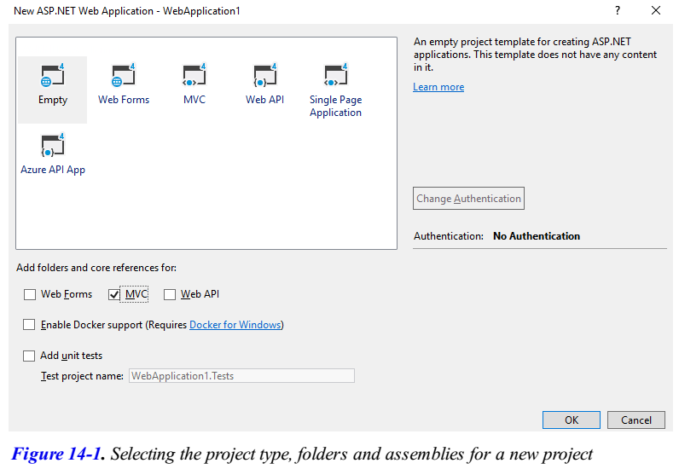
Figure 14-1

Slide 183
Templates: Comparison
The Empty project option just contains the basic references required for an MVC framework and the barebones folder structure.
There is a fair amount of content added by the MVC template and you can see the differences in Figure 14-2, which shows the contents of two newly created projects.
The one on the left was created with the Empty template with the MVC folders and references option checked.
The others show the content of a project that was created with the MVC template.
The extra files that the MVC project adds look worse than they really are. Some are related to authentication and others are JavaScript and CSS files for which there are regular and minified versions.
Visual Studio assembles a project created with the MVC template using NuGet packages, which means that you can see which packages are used by selecting Manage NuGet Packages for Solution from the Visual Studio Tools Library Package Manager menu.
It also means that you can add the same packages to any project, including one created with the Empty template.

Slide 184
Templates: Comparison |
Whichever template you choose, you will notice that the resulting projects have similar folder structures.
Some of the items in an MVC project have special roles, which are hard-coded into ASP.NET or the MVC Framework.
Others are subject to naming conventions. The description of the core files and folders in shown in Table 14-1, some of which are not present in projects by default

Slide 185
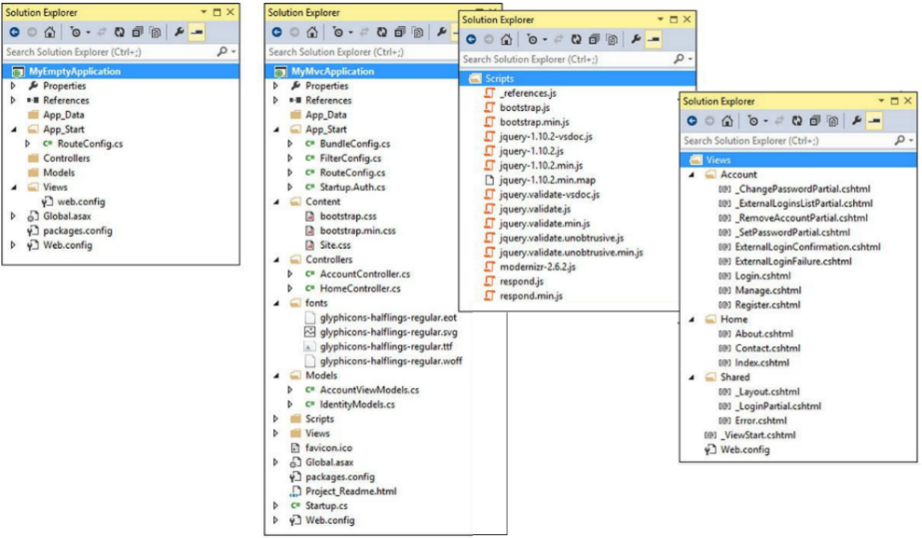
Figure 14-2

Slide 186
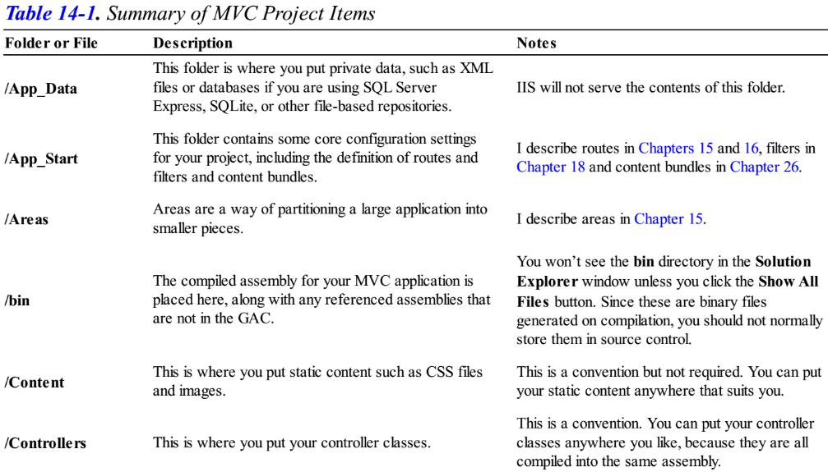
Table 14-1

Slide 187
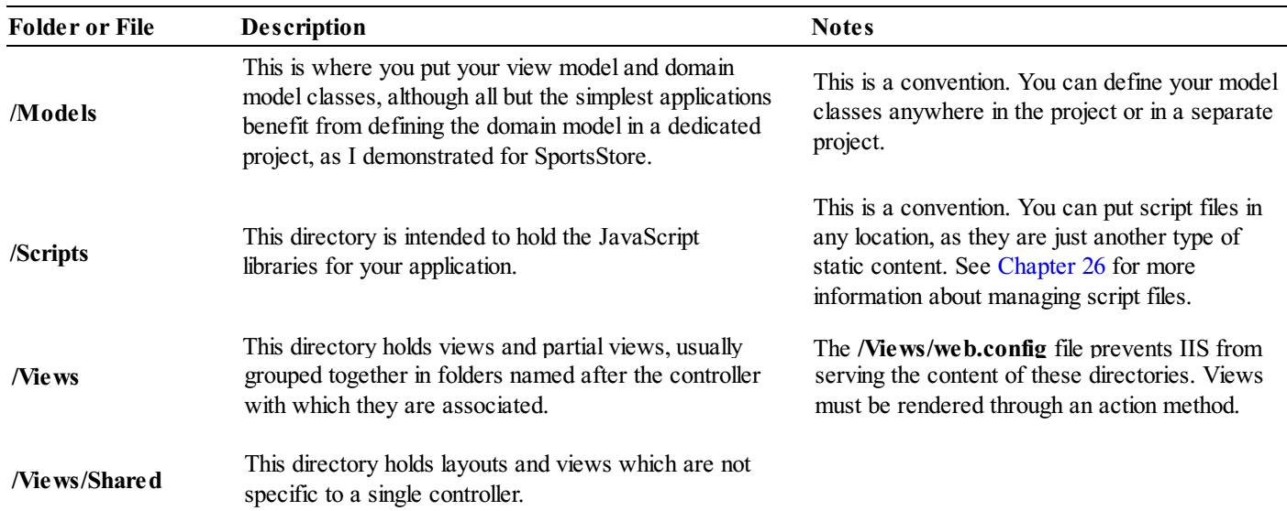
Table 14-1 |

Slide 188
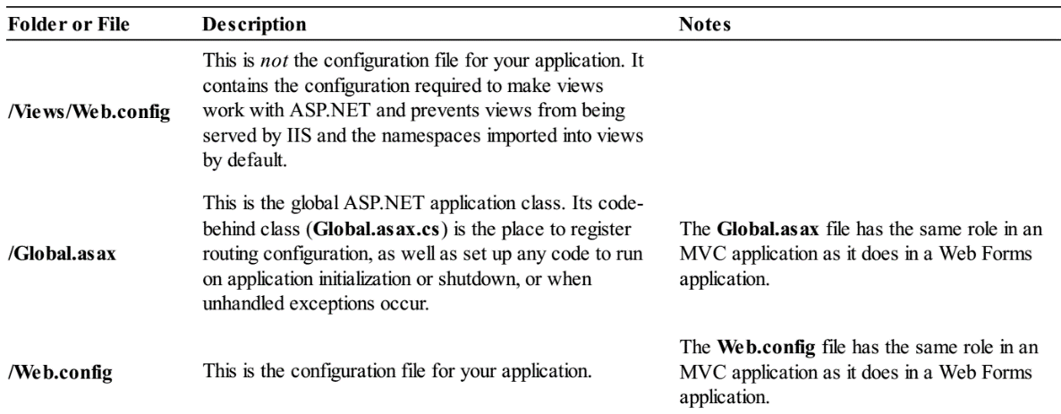
Table 14-1 ||

Slide 189
Understanding MVC Conventions
There are two kinds of conventions in an MVC project.
The first kind is just suggestions as to how you might like to structure your project.
For example, it is conventional to put your JavaScript files in the Scripts folder. This is where other MVC developers would expect to find them, and where NuGet packages will install them.
But you are free to rename the Scripts folder, or remove it entirely and put your scripts somewhere else.
That would not prevent the MVC Framework from running your application as long as the script elements in your views refer to the location you settle on.
The other kind of convention arises from the principle of convention over configuration, which was one of the main selling points that made Ruby on Rails so popular.
Convention over configuration means that you don’t need to explicitly configure associations between controllers and their views, for example.
You just follow a certain naming convention for your files, and everything just works.
There is less flexibility in changing your project structure when dealing with this kind of convention.

Slide 190
Following Conventions for Controller Classes
Controller classes must have names that end with Controller, such as ProductController, AdminController, and HomeController.
When referencing a controller from elsewhere in the project, such as when using an HTMLhelper method, you specify the first part of the name (such as Product), and the MVC Framework automatically appends Controller to the name and starts looking for the controller class.
You can change this behavior by creating your own implementation of the IControllerFactory interface.

Slide 191
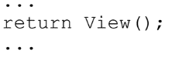
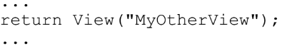
Following Conventions for Views
Views and partial views go into the folder /Views/ Controllername.
For example, a view associated with the ProductController class would go in the /Views/Product folder.
Notice that the Controller suffix is omitted from the Views folder: /Views/Product.
The MVC Framework expects that the default view for an action method should be named after that method.
For example, the default view associated with an action method called List should be called List.cshtml.
The default view is used when you return the result of calling the View method in an action method, like this:
You can specify a different view by name, like this:

Slide 192
Following Conventions for Views |
When looking for a view, the MVC Framework looks in the folder named after the controller and then in the /Views/Shared folder.
This means that I can put views that will be used by more than one controller in the /Views/Shared folder and the framework will find them.

Slide 193

Following Conventions for Layouts
The naming convention for layouts is to prefix the file with an underscore (_) character, and layout files are placed in the /Views/Shared folder.
This layout is applied to all views by default through the /Views/_ViewStart.cshtml file.
If you do not want the default layout applied to views, you can change the settings in _ViewStart.cshtml (or delete the file entirely) to specify another layout in the view, like this:

Slide 194
Debugging MVC Applications
You debug an ASP.NET MVC application in exactly the same way as you debug an ASP.NET Web Forms application.
The Visual Studio debugger is a powerful and flexible tool, with many features and uses.
I can only scratch the surface in this book, but in the sections that follow I show you how to set up the debugger and perform different debugging activities on your MVC project.

Slide 195
Preparing the Example Project
To demonstrate using the debugger, I have created a new MVC project using the MVC project template, just so you can see how the default content and configuration is set up and the effect of the default theme that is applied to views.
I called the new project DebuggingDemo.
I have chosen the Individual User Accounts authentication option, which sets up a basic user security system.
Click the OK button and Visual Studio will create the project and add the default packages, files, and folders that the MVC template includes.
You can see how the files and settings added to the project are applied by starting the application.
There are some placeholder elements for
the name of the application and branding, and
some pointers to
the MVC documents
NuGet, and
some hosting options

Slide 196
Preparing the Example Project |
The navigation bar at the top of the screen is the same kind I used for the SportsStore application and the layout has some responsive features.
Change the width of the window to see the effect.

Slide 197

Creating the Controller
Visual Studio creates a Home controller as part of the initial project content, but I am going to replace the code that Visual Studio added with that shown in Listing 14-1.

Slide 198
Creating the View
Visual Studio also created the Views/Home/Index.cshtml view file as part of the project setup.
I don’t need the default content and have to replace it with the markup shown in Listing 14-2.
The last preparatory step I need to take is to add a style to the /Content/Site.css file and change one of the existing ones, as shown in Listing 14-3.
The Site.css file is created by Visual Studio as part of the MVC project template and is the default location for application CSS styles. (I added a link element to the view in Listing 14-2 that imports this file into the Index.cshtml view.)

Slide 199

Listing 14-2

Slide 200

Listing 14-3

Slide 201
Launching the Visual Studio Debugger
Visual Studio prepares new projects for debugging automatically, but it is useful to understand how to change the configuration.
The important setting is in the Web.config file in the root project folder and can be found in the system.web element, as shown in Listing 14-4.
A lot of compilation in an MVC Framework project is done when the application is running in IIS, and so you need to ensure that the debug attribute on the compilation attribute is set to true during the development process.
This ensures that the debugger is able to operate on the classes files produced through on-demand compilation
In addition to the Web.config file, I want to ensure that Visual Studio includes debugging information in the class files that it creates.
This isn’t critical, but it can cause problems if the different debug settings are not in sync.
Ensure that the Debug configuration is selected in the Visual Studio toolbar, as shown in Figure 14-5.
To debug an MVC Framework application
select Start Debugging from the Visual Studio Debug menu or

Slide 202
Launching the Visual Studio Debugger |
click on the green arrow in the Visual Studio toolbar
If the debug attribute in the Web.config file is set to false when you start the debugger, then Visual Studio will display the dialog shown in Figure 14-6.
Select the option which allows Visual Studio to edit the Web.config file and click the OK button and the debugger will start.
The debugger will be attached to your application, but you will not notice any difference until the debugger breaks. (I explain what this means in the next section.)
To stop the debugger, select Stop Debugging from the Visual Studio Debug menu or close the browser window.

Slide 203


Listing 14-6

Slide 204
Caution
Do not deploy your application to a production server without setting the debug value to false.
If you are using Visual Studio to deploy your application (as I did in Chapter 13), then the setting will be changed automatically when you select the Release configuration for the project.

Slide 205
Causing the Visual Studio Debugger to Break
An application that is running with the debugger attached will behave normally until a break occurs, at which point the execution of the application is halted and control is turned over to the debugger.
While in this state, you can inspect and control the state of the application.
Breaks occur for two main reasons:
when a breakpoint is reached and
when an unhandled exception arises
You will see examples of both in the following sections.

Slide 206
Using Breakpoints
A breakpoint is an instruction that tells the debugger to halt execution of the application and hand control to the programmer.
You can inspect the state of the application and see what is happening and, optionally, resume execution again.
To create a breakpoint, right-click a code statement and select Breakpoint Insert Breakpoint from the pop-up menu.
As a demonstration, apply a breakpoint to the first statement in the Index action method of the Home controller and you will see a red dot appear in the margin of the text editor, as shown in Figure 14-8.
To see the effect of the breakpoint, start the debugger by selecting Start Debugging from the Visual Studio Debug menu.
The application will run until the statement to which the breakpoint has been applied is reached, at which point the debugger will break, halting execution of the application and transferring control.
Visual Studio highlights the point at which the execution has been stopped with yellow highlights.
Once you have control of the application’s execution, you can move to the next statement, follow execution into other methods and generally explore the state of your application.
You can do this using the toolbar buttons or using the items in the Visual Studio Debug menu.

Slide 207
Using Breakpoints |
In addition to giving you control of the execution of the app, Visual Studio provides you with a lot of useful information about the state of your app.
In fact, there is so much information that I only have room to show you the basics.

Slide 208

Figure 14-8

Slide 209
NOTE
A breakpoint is triggered only when the statement it is associated with is executed.
My example breakpoint was reached as soon as the application was started because it is inside the action method that is called when a request for the default URL is received.
If you place a breakpoint inside another action method, you must use the browser to request a URL associated with that method.
This can mean working with the application in the way a user would or navigating directly to the URL in the browser window.

Slide 210
Viewing Data Values in the Code Editor
The most common use for is to track down bugs in your code.
Before you can fix a bug, you have to figure out what is going on and one of the most useful features that Visual Studio provides is the ability to view and monitor the values of variables right in the code editor.
As an example, start the app using the debugger and wait until the breakpoint I added in the previous section is reached. When the debugger breaks, move the mouse pointer over the statement that defines the result variable. You will see a small pop-up which shows you the current value, as illustrated by Figure 14-10. It can be hard to make out the pop-up, so I have shown a magnified version in the figure.
The execution of the statements in the Index action method has not reached the point where a value has been assigned to the result variable, so Visual Studio shows the default value, which is 0 for the int type. Select the Step Over menu item in the Visual Studio Debug menu (or press F10) to advance the point of execution to the statement which defines the ViewBag.Message property and hold your mouse over the result variable again. The debugger executed the statement that assigns a value to the result variable, and you can see the effect in Figure 14-11.
I use this feature when I start the process of tracking down a bug because it gives an immediate insight into what is going on inside the app. I find it especially useful for spotting null values, which indicate that a variable has not been assigned a value (a cause of many bugs early in the development process, in my experience). You will notice that there is a pushpin icon to the right of the value in the pop-up. If you click on this, the pop-up becomes permanent and will indicate when the value of the variable changes. This allows you to monitor one or more variables and see when they change and what their new values are.
(Page 432).

Slide 211
Viewing Application State in the Debugger
Visual Studio provides a number of different windows that you can use to get information about your app while the execution has been halted following a breakpoint. A complete list of the windows available is shown on the Debug Windows menu, but two of the most useful are the Locals and Call Stack windows. The Locals window automatically displays the value of all of the variables in the current scope, as Figure 14-12 illustrates. This gives you an all-in-one view of the variables, which are likely to be of interest.
Variables whose values were changed by the previously executed statement are shown in red. In the figure, the result variable is red because I just executed the statement that assigns a value.
The Call Stack window shows you the sequence of calls that have led to the current statement being executed. This can be helpful if you are trying to figure out odd behavior because you can unwind the call stack and explore the circumstances that led to the breakpoint being triggered. (I have not shown you the Call Stack window in a figure because the example app doesn’t have enough call depth to provide a useful insight. But I recommend you explore this and the other Visual Studio windows to get more of an idea of what information the debugger is able to provide.)

Slide 212
Tip
The set of variables shown in the Locals window changes as you navigate through the application, but if you want to keep an eye on a variable globally, then right-click on one of the items shown in the Locals window and select the Add Watch option.
The items in the Watch window don’t change as you execute statements in the app, providing you with a fixed point of reference.
You can add breakpoints to views.
This can be helpful for inspecting the values of view model properties, for example.
You add a breakpoint to a view just as I did in the code file: right-click the Razor statement that you are interested in and select Breakpoint Insert Breakpoint.

Slide 213
Breaking on Exceptions
Unhandled exceptions are a fact of development. One of the reasons that I unit and integration test my projects is to minimize the likelihood that such an exception will occur in production. As an aid to finding and fixing unhandled exceptions, the Visual Studio debugger will break automatically when it encounters one.
To demonstrate breaking on an exception, I have made a small change to the Index action method in the Home controller, as shown in Listing 14-5.
I changed the value of the secondVal variable to be 0, which will cause an exception in the statement that divides firstVal by secondVal.
When you start the debugger, the application will run until the exception is thrown, at which point the exception helper pop-up will appear, as shown in Figure 14-13.
The exception helper gives you details of the exception. When the debugger breaks on an exception, you can inspect the application state and control execution, just as when a breakpoint is hit.
(Page 435).
(Page 434).

Slide 214
NOTE
Only unhandled exceptions cause the debugger to break.
An exception becomes handled if you catch and handle it in a try...catch block.
Handled exceptions can be a useful programming tool.
They are used to represent the scenario where a method was unable to complete its task and needs to notify its caller.
Unhandled exceptions are bad, because they represent an unforeseen condition and because they generally drop the user into an error page.

Slide 215
Using Edit and Continue
An interesting Visual Studio debugging feature is called Edit and Continue. When the debugger breaks, you can edit your code and then continue debugging. Visual Studio recompiles your application and re-creates the state of your application at the moment of the debugger break.
(Page 435).

Slide 216
Enabling Edit and Continue
I need to make sure that Edit and Continue is enabled in two places: In the Edit and Continue section of the Debugging options (select Options from the Visual Studio Tools menu), make sure that Enable Edit and Continue is checked, as shown in Figure 14-14.
In the project properties (select DebuggingDemo Properties from the Visual Studio Project menu), click the Web section and ensure that Enable Edit and Continue is checked, as shown in Figure 14-15.
(Page 436).
(Page 436).
(Page 435).

Slide 217
Modifying the Project
The Edit and Continue feature is somewhat picky. There are some conditions under which it cannot work. One such condition is present in the Index action method of the HomeController class: the use of dynamic objects. To work around this, I have commented out the line that uses the view bag in the HomeController.cs class, as shown in Listing 14-6.
I need to make a corresponding change in the Index.cshtml view, as shown in Listing 14-7.
(Page 438).
(Page 437).

Slide 218
Editing and Continuing
I am now ready for a demonstration of the Edit and Continue feature. Begin by selecting Start Debugging from the Visual Studio Debug menu. The application will be started with the debugger attached and run until it reaches the line where I perform the calculation in the Index method. The value of the second parameter is zero, which causes an exception to be thrown. At this point, the debugger halts execution, and the exception helper pops up (just like the one shown in Figure 14-13). Click the Enable editing link in the exception helper window. In the code editor, change the expression that calculates the value for the result variable, as follows:
I have removed the reference to the secondVal variable and replaced it with a numeric literal value of 2. Now select Continue from the Visual Studio Debug menu to resume execution of the application. The new value is used to generate the value for the result variable, producing the output shown in Figure 14-16.
Take a moment to reflect on what happened here. I started the application with a bug in it: an attempt to divide a value by zero. The debugger detected the exception and stopped executing the program. I edited the code and then told the debugger to continue the execution. At this point, Visual Studio recompiled the application, restored its state and continued execution as normal using the new value. The browser received the rendered result, which reflected the new data value. Without Edit and Continue, I would have needed to stop the application, make a change, compile the application, and restart the debugger. I would then use the browser to repeat the steps that I took up to the moment of the debugger break. It is avoiding this last step that can be the most important. Complex bugs may require many steps through the application to re-create, and the ability to test potential fixes without needing to repeat those steps over and over can save the programmer’s time and sanity.
(Page 439).

Slide 219
Using Browser Link
Visual Studio 2013 includes a feature called browser link that allows you to view the application in multiple browsers simultaneously and have them all reload when you make a change.
This feature is most useful once an application has stabilized and you are doing fit and finish work on the HTML and CSS that your views generate. (I’ll explain why shortly.)
To use browser link, click on the small down arrow next to the selected browser on the Visual Studio toolbar and select Browse With from the menu, as shown in Figure 14-17.
The Browse With dialog window will appear.
Hold the control key and select the browsers that you want to use.
In Figure 14-18, you can see that I have chosen Internet Explorer and Chrome.
You can also use this dialog to add new browsers (although Visual Studio is pretty good at detecting most of the mainstream ones).
Click the Browse button and Visual Studio will open the browsers you have selected and have each of them load the project URL.
You can edit the code and views in the application and then update all of the browser windows by selecting Refresh Linked Browsers from the Visual Studio toolbar, as shown in Figure 14-19.
The application will be compiled automatically so that you can see changes.

Slide 220
Using Browser Link |
This feature works by including some JavaScript in the HTML sent to the browser and it can be a nice way of developing iteratively.
The reason that I recommend it only for working on views is that they are less likely to cause IIS to send HTTP error messages to the browser, which is what happens when there is an error in the code.
The JavaScript code isn’t added to error responses, which means that the link between Visual Studio and the browsers is lost.
You have to start over using the Browse With menu.
The browser link feature is a good idea, but the use of JavaScript is a problem.
I use a similar tool called LiveReload (http://livereload.com) for my non-ASP.NET development and it provides a better approach because it uses browser plugins that are not affected by HTTP error messages.
The value of Visual Studio browser link will be limited until Microsoft takes a similar approach.

Slide 221

Figure 14-17

Slide 222

Figure 14-18

Slide 223

Figure 14-19

Slide 224

15
URL Routing

Slide 225
Intro
Before the introduction of the MVC Framework, ASP.NET assumed that there was a direct relationship between requested URLs and the files on the server hard disk.
The job of the server was to receive the request from the browser and deliver the output from the corresponding file.
This approach works just fine for Web Forms, where each ASPX page is both
a file and
a self-contained response to a request
It doesn’t make sense for an MVC application, where requests are processed by action methods in controller classes and there is no one-to-one correlation to the files on the disk.
To handle MVC URLs, the ASP.NET platform uses the routing system.

Slide 226
Agenda
In this chapter, I will show you how to use the routing system to create powerful and flexible URL handling for your projects.
As you will see, the routing system lets you
create any pattern of URLs you desire and
express them in a clear and concise manner
The routing system has two functions:
Examine an incoming URL and figure out for which controller and action the request is intended.
Generate outgoing URLs. These are the URLs that appear in the HTML rendered from views so that a specific action will be invoked when the user clicks the link (at which point, it has become an incoming URL again).
In this chapter, I will focus on defining routes and using them to process incoming URLs so that the user can reach your controllers and actions.
There are two ways to create routes in an MVC Framework application:
convention-based routing and
attribute routing

Slide 227
Agenda |
You will be familiar with convention-based routing if you have used earlier versions of the MVC Framework, but attribute routing is new to MVC 5.
I explain both approaches in this chapter.
Then, in the next chapter, I will show you how to use those same routes to generate the outgoing URLs you will need to include in your views, as well as show you how to customize the routing system and use a related feature called areas.
Table 15-1 provides the summary for this chapter.

Slide 228

Table 15-1

Slide 229
Preparing the Example Project
To demonstrate the routing system, I need a project to which I can add routes. I created a new MVC application using the Empty template, and I called the project UrlsAndRoutes. I added a test project to the Visual Studio solution called UrlsAndRoutes.Tests by checking the Add Unit Tests option, as shown in Figure 15-1.
(Page 444).

Slide 230
Creating the Example Controllers
To demonstrate the routing feature, I am going to add some simple controllers to the example application. I only care about the way in which URLs are interpreted in order to call action methods, so the view models I use are string values in the view bag which report the controller and action method name. First, create a Home controller and set its contents to match those in Listing 15-1.
(Page 445).

Slide 231
Creating the View
I specified the ActionName view in all of the action methods in these controllers, which allows me to define one view and use it throughout the example application. Create a folder called Shared in the Views folder and add a new view called ActionName.cshtml to it, setting the contents of the view to match Listing 15-4.
(Page 447).

Slide 232
Setting the Start URL and Testing the Application
As I explained in Part 1 of this book, Visual Studio will try to figure out the URLyou want the browser to request based on the file you are editing when you start the debugger. This is a good idea that quickly becomes annoying and is a feature that I always disable. Select UrlsAndRoutes Properties from the Visual Studio Project menu, switch to the Web tab and check the Specific Page option in the Start Action section. You don’t have to provide a value—just checking the option is enough. If you start the example app, you will see the response shown in Figure 15-2.
(Page 447).

Slide 233
Introducing URL Patterns
The routing system works its magic using a set of routes. These routes collectively comprise the URL schema or scheme for an application, which is the set of URLs that your application will recognize and respond to. I do not need to manually type out all of the individual URLs I am willing to support in my applications. Instead, each route contains a URL pattern, which is compared to incoming URLs. If a URLmatches the pattern, then it is used by the routing system to process that URL. Let’s start with a URLfor the example application:
(Page 448).

Slide 234
Creating and Registering a Simple Route
Once you have a URLpattern in mind, you can use it to define a route. Routes are defined in the RouteConfig.cs file, which is in the App_Start project folder. You can see the initial content that Visual Studio defines for this file in Listing 15-5.
(Page 450).

Slide 235
Using the Simple Route
You can see the effect of the changes I made to the routing by starting the example application. You will see an error when the browser tries to navigate to the root URLfor the application, but if you
(Page 452).

Slide 236
Defining Default Values
The reason that I got an error when I requested the default URLfor the application is that it didn’t match the route I had defined. The default URLis expressed as ∼/ to the routing system and there are no segments in this string that can be matched to the controller and action variables defined by the simple route pattern. I explained earlier that URLpatterns are conservative, in that they will match only URLs with the specified number of segments. I also said that this was the default behavior and one way to change this behavior is to use default values. A default value is applied when the URLdoesn’t contain a segment that can be matched to the value. Listing 15-9 provides an example of a route that contains a
(Page 457).

Slide 237
Using Static URL Segments
Not all of the segments in a URL pattern need to be variables. You can also create patterns that have static segments. Suppose that I want to match a URL like this to support URLs that are prefixed with Public:
(Page 460).

Slide 238
Defining Custom Segment Variables
The controller and action segment variables have special meaning to the MVC Framework and, obviously, they correspond to the controller and action method that will be used to service the request. But these are only the built-in segment variables. I can also define my own variables, as shown in Listing 15-15. (I have removed the existing routes from the previous section so I can start over.)
(Page 465).

Slide 239
Using Custom Variables as Action Method Parameters
Using the RouteData.Values property is only one way to access custom route variables. The other way is much more elegant. If I define parameters to the action method with names that match the URLpattern variables, the MVC Framework will pass the values obtained from the URLas parameters to the action method. For example, the custom variable I defined in the route in Listing 15- 15 is called id. I can modify the CustomVariable action method in the Home controller so that it has a matching parameter, as shown in Listing 15-18.
(Page 468).

Slide 240
Defining Optional URL Segments
An optional URL segment is one that the user does not need to specify, but for which no default value is specified. Listing 15-19 shows an example, and you can see that I specify that a segment variable is optional by setting the default value to UrlParameter.Optional.
(Page 469).

Slide 241
Defining Variable-Length Routes
Another way of changing the default conservatism of URLpatterns is to accept a variable number of URLsegments. This allows you to route URLs of arbitrary lengths in a single route. You define support for variable segments by designating one of the segment variables as a catchall, done by prefixing it with an asterisk (*), as shown in Listing 15-23.
(Page 472).

Slide 242
Prioritizing Controllers by Namespaces
When an incoming URL matches a route, the MVC Framework takes the value of the controller variable and looks for the appropriate name. For example, when the value of the controller variable is Home, then the MVC Framework looks for a controller called HomeController. This is an unqualified class name, which means that the MVC Framework doesn’t know what to do if there are two or more classes called HomeController in different . To demonstrate the problem, create a new folder in the root of the example project called AdditionalControllers and add a new Home controller, setting the contents to match those in Listing 15-24.
(Page 474).

Slide 243
Constraining Routes
At the start of the chapter, I described how URLpatterns are conservative in how they match segments and liberal in how they match the content of segments. The previous few sections have explained different techniques for controlling the degree of conservatism: making a route match more or fewer segments using default values, optional variables, and so on. It is now time to look at how to control the liberalism in matching the content of URLsegments: how to restrict the set of URLs that a route will match against. Once I have control over both of these aspects of the behavior of a route, I can create URLschemas that are expressed with laser-like precision.
(Page 478).

Slide 249
Using Attribute Routing
All of the examples so far in this chapter have been defined using a technique known as conventionbased routing. MVC 5 adds support for a new technique known as attribute routing, in which routes are defined by C# attributes that are applied directly to the controller classes. In the sections that follow, I’ll show you how to create and configure routes using attributes, which can be mixed freely with the standard convention-based routes.
(Page 488).

Slide 254

16
Advanced Routing Features

Slide 255
Intro
In the previous chapter, I showed you how to use the routing system to handle incoming URLs, but this is only part of the story. You also need to be able use your URLschema to generate outgoing URLs you can embed in your views, so that users can click links and submit forms back to your application in a way that will target the correct controller and action. In this chapter, I will show you different techniques for generating outgoing URLs, show you how to customize the routing system by replacing the standard MVC routing implementation classes and use the MVC Framework areas feature, which allows you to break a large and complex MVC application into manageable chucks. I finish this chapter with some best-practice advice about URLschemas in MVC Framework applications. Table 16-1 provides the summary for this chapter.
(Page 497).

Slide 256
Preparing the Example Project
I am going to continue to use the UrlsAndRoutes project from the previous chapter, but I need to make a couple of changes. First, I deleted the AdditionalControllers folder and HomeController.cs file that it contains. To perform the deletion, right-click on the AdditionalControllers folder and select Delete from the pop-up menu.
(Page 498).

Slide 260
Generating Outgoing URLs in Views
In almost every MVC Framework application, you will want to allow the user to navigate from one view to another, which will usually rely on including a link in the first view that targets the action method that generates the second view. It is tempting to just add a static a element whose href attribute targets the action method, like this:
(Page 499).

Slide 269
Customizing the Routing System
You have seen how flexible and configurable the routing system is, but if it does not meet your requirements, you can customize the behavior. In this section, I will show you the two ways to do this.
(Page 514).

Slide 270
Creating a Custom RouteBase Implementation
If you do not like the way that standard Route objects match URLs, or want to implement something unusual, you can derive an alternative class from RouteBase. This gives you control over how URLs are matched, how parameters are extracted, and how outgoing URLs are generated. To derive a class from RouteBase, you need to implement two methods: GetRouteData (HttpContextBase httpContext): This is the mechanism by which inbound URL matching works. The framework calls this method on each RouteTable.Routes entry in turn, until one of them returns a non-null value. GetVirtualPath (RequestContext requestContext, RouteValueDictionary values): This is the mechanism by which
(Page 514).

Slide 271
Creating a Custom Route Handler
I have relied on the MvcRouteHandler in my routes because it connects the routing system to the MVC Framework, the focus of this book. Even so, the routing system lets me define my own route handler by implementing the IRouteHandler interface. Listing 16-22 shows the content of the CustomRouteHandler.cs class file that I added to the Infrastructure folder in the example project.
(Page 520).

Slide 272
Working with Areas
The MVC Framework supports organizing a Web application into areas, where each area represents a functional segment of the application, such as administration, billing, customer support, and so on. This is useful in a large project, where having a single set of folders for all of the controllers, views, and models, and it can become difficult to manage. Each MVC area has its own folder structure, allowing you to keep everything separate. This makes it more obvious which project elements relate to each functional area of the application, helping multiple developers to work on the project without colliding with one another. Areas are supported largely through the routing system, which is why I have chosen to cover this feature alongside URLs and routes. In this section, I will show you how to set up and use areas in your MVC projects.
(Page 522).

Slide 278
Routing Requests for Disk Files
Not all of the requests for an MVC application are for controllers and actions. Most applications need a way to serve content such as images, static HTMLfiles, JavaScript libraries, and so on. As a demonstration, I created a Content folder and added a file called StaticContent.html to it using the HTML Page item template. Listing 16-31 shows the contents of the HTMLfile.
(Page 531).

Slide 280
Bypassing the Routing System
Setting the RouteExistingFiles property, which I demonstrated in the previous section, makes the routing system more inclusive. Requests that would normally bypass the routing system are now evaluated against the routes the application defines. The counterpart to this feature is the ability to make the routing system less inclusive and prevent URLs from being evaluated against routes. This is done using the IgnoreRoute method of the RouteCollection class, as shown in Listing 16-34.
(Page 536).

Slide 281
URL Schema Best Practices
After all of this, you may be left wondering where to start in designing your own URLschema. You could just accept the default schema that Visual Studio generates for you, but there are benefits in giving your schema some thought. In recent years, the design of an application’s URLs have been taken increasingly seriously and a few important design principles have emerged. If you follow these design patterns, you will improve the usability, compatibility, and search-engine rankings of your applications.
(Page 537).

Slide 282

17
Controllers & Actions

Slide 283
Intro
Every request that comes to your application is handled by a controller.
The controller is free to handle the request any way it sees fit, as long as it doesn’t stray into the areas of responsibility that belong to the model and view.
This means that controllers do not contain or store data, nor do they generate user interfaces.
In the ASP.NET MVC Framework, controllers are .NET classes that contain the logic required to handle a request.
In Chapter 3, I explained that the role of the controller is to encapsulate your application logic.
This means that controllers are responsible for
processing incoming requests
performing operations on the domain model
selecting views to render to the user
In this chapter, I show you how controllers are implemented and the different ways that you can use controllers to receive and generate output.
Table 17-1 provides the summary for this chapter.

Slide 284

Table 17-1

Slide 285
Preparing the Example Project
To prepare for this chapter, I created a new project called ControllersAndActions using the Empty template, checking the option for the MVC folders and references to create a unit test project called ControllersAndActions.Tests. The unit tests that I create in this chapter don’t need mock implementations and so I don’t need to install the Moq package, but I do need to install the MVC package so that my tests have access to the base controller classes. Enter the following command into the Visual Studio NuGet Package Manager Console:
(Page 541).

Slide 286
Introducing the Controller
You have seen the use of controllers in almost all of the chapters so far. Now it is time to take a step back and look behind the scenes.
(Page 541).

Slide 287
Receiving Request Data
Controllers frequently need to access data from the incoming request, such as
query string values
form values
parameters parsed from the URL by the routing system
There are three main ways to access that data:
Extract it from a set of context objects
Have the data passed as parameters to your action method
Explicitly invoke the framework’s model binding feature.
Here, I look at the approaches for getting input for your action methods, focusing on using context
(Page 546).

Slide 288
Producing Output
After a controller has finished processing a request, it usually needs to generate a response.
When I created the bare-metal controller by implementing the IController interface directly, I needed to take responsibility for
every aspect of processing a request,
including generating the response to the client
If I want to send an HTML response, for example, then I must create and assemble the HTML data and send it to the client using the Response.Write method.
Similarly, if I want to redirect the user’s browser to another URL, I need to call the Response.Redirect method and pass the URL I am interested in directly.
Both of these approaches are shown in Listing 17-7, which shows enhancements to the BasicController class.

Slide 289

Listing 17-7

Slide 290
Understanding Action Results
The MVC Framework uses action results to separate stating intentions from executing intentions.
The concept is simple once you have mastered it, but it takes a while to get your head around the approach at first because there is a little bit of indirection going on.
Instead of working directly with the Response object, action methods return an object derived from the ActionResult class that describes what the response from controller will be, such as rendering a view or redirecting to another URL or action method.
But—and this is where the indirection comes in—you don’t generate the response directly.
Instead, you create an ActionResult object that the MVC Framework processes to produce the result for you, after the action method has been invoked.
(Page 553).
(Page 552).

Slide 291
Returning HTML by Rendering a View
The most common kind of response from an action method is to generate HTML and send it to the browser.
To demonstrate how to render views, I added a controller called Example to the project.
You can see the contents of the ExampleController.cs class file in Listing 17-13.
(Page 556).

Slide 292
Passing Data from an Action Method to a View
The MVC Framework provides a number of different ways to pass data from an action method to a view, which I describe in the following sections.
I touch on the topic of views, which I cover in depth in Chapter 20.
In this chapter, I discuss only enough view functionality to demonstrate the controller features of interest.
(Page 561).

Slide 293
Performing Redirections
A common result from an action method is not to produce any output directly, but to redirect the user’s browser to another URL.
Most of the time, this URL is another action method in the application that generates the output you want the users to see.
When you perform a redirect, you send one of two HTTP codes to the browser:
Send the HTTP code 302, which is a temporary redirection.
This is the most frequently used type of redirection and when using the Post/Redirect/Get pattern, this is the code that you want to send.
Send the HTTP code 301, which indicates a permanent redirection.
This should be used with caution, because it instructs the recipient of the HTTP code not to request the original URL ever again and to use the new URL that is included alongside the redirection code.
If you are in doubt, use temporary redirections; that is, send code 302.

Slide 294
THE POST/REDIRECT/GET PATTERN
The most frequent use of a redirect is in action methods that process HTTP POST requests.
As I mentioned in the previous chapter, POST requests are used when you want to change the state of an application.
If you just return HTML following the processing of a request, you run the risk that the user will click the browser’s reload button and resubmit the form a second time, causing unexpected and undesirable results.
To avoid this problem, you can follow the pattern called Post/Redirect/Get.
In this pattern, you receive
a POST request
process it
redirect the browser so that a GET request is made by the browser for another URL
GET requests should not modify the state of your application, so any inadvertent resubmissions of this request won’t cause any problems.

Slide 295
Redirecting to a Literal URL
The most basic way to redirect a browser is to call the Redirect method, which returns an instance of the RedirectResult class, as shown in Listing 17-20.
The URL you want to redirect to is expressed as a string and passed as a parameter to the Redirect method.
The Redirect method sends a temporary redirection.
You can send a permanent redirection using the RedirectPermanent method, as shown in Listing 17-21.

Slide 296

Listing 17-20

Slide 297

Listing 17-21

Slide 298
TIP
If you prefer, you can use the overloaded version of the Redirect method, which takes a bool parameter that specifies whether or not a redirection is permanent.

Slide 299
UNIT TEST: LITERAL REDIRECTIONS
Literal redirections are easy to test.
You can read the URL and test whether the redirection is permanent or temporary using the Url and Permanent properties of the RedirectResult class.
The following is a test method for the redirection shown in Listing 17-21.

Slide 300

Listing 17-21

Slide 301
Redirecting to a Routing System URL
If you are redirecting the user to a different part of your application, you need to make sure that the URL you send is valid within your URL schema.
The problem with using literal URLs for redirection is that any change in your routing schema means that you need to go through your code and update the URLs.
Fortunately, you can use the routing system to generate valid URLs with the RedirectToRoute method, which creates an instance of the RedirectToRouteResult, as shown in Listing 17-22.
The RedirectToRoute method issues a temporary redirection.
Use the RedirectToRoutePermanent method for permanent redirections.
Both methods take an anonymous type whose properties are then passed to the routing system to generate a URL.
For more details of this process, see the Chapters 15 and 16.

Slide 302

Listing 17-22

Slide 303
UNIT TESTING: ROUTED REDIRECTIONS
Here is the unit test for the action method in Listing 17-22:
You can see that I have tested the result indirectly by looking at the routing information provided by the RedirectToRouteResult object, which means that I don’t have to parse a URL.

Slide 304

Redirecting to an Action Method
You can redirect to an action method more elegantly by using the RedirectToAction method (for temporary redirections) or the RedirectToActionPermanent (for permanent redirections).
These are just wrappers around the RedirectToRoute method that lets you specify values for the action method and the controller without needing to create an anonymous type, as shown in Listing 17-23.
If you just specify an action method, then it is assumed that you are referring to an action method in the current controller.
If you want to redirect to another controller, you need to provide the name as a parameter, like this:
There are other overloaded versions that you can use to provide additional values for the URL generation.
These are expressed using an anonymous type, which does tend to undermine the purpose of the convenience method, but can still make your code easier to read.

Slide 305

Listing 17-23

Slide 306
NOTE
The values that you provide for the action method and controller are not verified before they are passed to the routing system.
You are responsible for making sure that the targets you specify actually exist.

Slide 307

PRESERVING DATA ACROSS REDIRECTION
A redirection causes the browser to submit an entirely new HTTP request, which means that you do not have access to the details of the original request.
If you want to pass data from one request to the next, you can use the Temp Data feature.
TempData is similar to Session data, except that TempData values are marked for deletion when they are read, and they are removed when the request has been processed.
This is an ideal arrangement for short-lived data that you want to persist across a redirection.
Here is a simple example in an action method that uses the RedirectToAction method:
When this method processes a request, it sets values in the TempData collection, and then redirects the user’s browser to the Index action method in the same controller.

Slide 308


PRESERVING DATA ACROSS REDIRECTION |
You can read the TempData values back in the target action method, and then pass them to the view, like this:
A more direct approach would be to read these values in the view, like this:

Slide 309

PRESERVING DATA ACROSS REDIRECTION ||
Reading the values in the view means that you do not need to use the View Bag feature in the action method.
However, you must cast the TempData results to an appropriate type.
You can get a value from TempData without marking it for removal by using the Peek method, like this:
You can preserve a value that would otherwise be deleted by using the Keep method, like this:
The Keep method doesn’t protect a value forever.
If the value is read again, it will be marked for removal once more.
If you want to store items so that they won’t be removed when the request is processed then use session data instead.

Slide 310
Returning Errors and HTTP Codes
(Page 571).

Slide 311

Filters
18

Slide 312
Intro
Filters inject extra logic into MVC Framework request processing.
They provide a simple and elegant way to implement cross-cutting concerns.
This term refers to functionality that is used all over an application and doesn’t fit neatly into any one place, where it would break the separation of concerns pattern.
Classic examples of cross-cutting concerns are
Logging
Authorization and
Caching
In this chapter, I show you the different categories of filters that the MVC Framework supports, how to create and use custom filters, and how to control their execution.
Table 18-1 provides the summary for this chapter.

Slide 313

Table 18-1

Slide 322

19
Controller Extensibility

Slide 323
Intro
In this chapter, I am going to show you some of the advanced MVC features for working with controllers. I start this chapter by exploring the parts of the request handling process that lead to the execution of an action method and demonstrating the different ways to take control of it. Figure 19-1 shows the basic flow of control between components.
My focus for the first part of this chapter is the controller factory and the action invoker. The names of these components suggest their purpose. The controller factory is responsible for creating instances of controllers to service a request and the action invoker is responsible for finding and invoking the action method in the controller class. The MVC Framework includes default implementations of both of these components, and I will show you how to configure and control their behavior. I will also show you how to replace these components entirely and use custom logic. Table 19-1 provides the summary for this chapter.
(Page 627).
(Page 627).

Slide 324
Preparing the Example Project
For this chapter, I created a project called ControllerExtensibility using the Empty template option and enabled the option to add the core MVC references and folders. I need some simple controllers to work with in this chapter, so that I can demonstrate the different kinds of extensibility features that are available. To get set up, I created the Result.cs file in the Models folder and used it to define the Result class shown in Listing 19-1.
(Page 628).

Slide 325
Creating a Custom Controller Factory
As with much of the MVC Framework, the best way to understand how controller factories work is to create a custom implementation. I do not recommend that you do this in a real project, as there are easier ways to create custom behavior by extending the built-in factory. But this is a nice way to demonstrate how the MVC framework creates instances of controllers. Controller factories are defined by the IControllerFactory interface, which is shown in Listing 19-5.
(Page 630).

Slide 326
Working with the Built-in Controller Factory
I showed you how to create a custom controller factory because it is the most effective way of demonstrating what a controller factory does and how it functions. For most applications, however, the built-in controller factory class, called DefaultControllerFactory, is perfectly adequate. When it receives a request from the routing system, this factory looks at the routing data to find the value of the controller property and tries to find a class in the Web application that meets the following criteria: The class must be public. The class must be concrete (not abstract). The class must not take generic parameters. The name of the class must end with Controller. The class must implement the IController interface. The DefaultControllerFactory class maintains a list of such classes in the application so that it does not need to perform a search every time a request arrives. If a suitable class is found, then an instance is created using the controller activator (I will come back to this in the upcoming “Customizing DefaultControllerFactory Controller Creation” section), and the job of the controller is complete. If there is no matching controller, then the request cannot be processed any further.
(Page 636).

Slide 327
Creating a Custom Action Invoker
Once the controller factory has created an instance of a class, the framework needs a way of invoking an action on that instance. If you derived your controller from the Controller class, then this is the responsibility of an action invoker, which is the subject of this section.
(Page 641).

Slide 328
Using the Built-in Action Invoker
The built-in action invoker, which is the ControllerActionInvoker class, has some sophisticated techniques for matching requests to actions. And, unlike my implementation in the previous section, the default action invoker operates on methods. To qualify as an action, a method must meet the following criteria: The method must be public. The method must not be static. The method must not be present in System.Web.Mvc.Controller or any of its base classes. The method must not have a special name. The first two criteria are simple enough. For the next, excluding any method that is present in the Controller class or its bases means that methods such as ToString and GetHashCode are excluded, as are the methods that implement the IController interface. This is sensible, because the inner workings of controllers should not be exposed to the outside world. The last criterion means that constructors, property and event accessors are excluded. In fact, no class member that has the IsSpecialName flag from System.Reflection.MethodBase will be used to process an action.
(Page 643).

Slide 329
Improving Performance with Specialized Controllers

Slide 330

20
Views

Slide 331
Intro
In Chapter 17, you saw how action methods can return ActionResult objects.
As you learned, the most commonly used action result is ViewResult, which causes a view to be rendered and returned to the client.
You have seen views being used in many examples already, so you know roughly what they do.
In this chapter, I focus and clarify that knowledge.
I begin by showing you how the MVC Framework handles ViewResults using view engines, including demonstrating how to create a custom view engine.
Next, I will describe techniques for working effectively with the built-in Razor View Engine.
Then I will cover how to create and use
partial views
child actions
Razor sections
which are all essential topics for effective MVC development.
Table 20-1 provides the summary for this chapter.

Slide 332

Table 20-1

Slide 333
Creating a Custom View Engine

Slide 334
Working with the Razor Engine

Slide 335
Adding Dynamic Content to a Razor View
The whole purpose of views is to allow you to render parts of your domain model as a user interface.
To do that, you need to be able to add dynamic content to views.
Dynamic content is generated at runtime, and can be different for each and every request.
This is opposed to static content, such as HTML, which you create when you are writing the application and is the same for each and every request.
You can add dynamic content to views in the different ways described in Table 20-5.

Slide 336

Table 20-5

Slide 337
Using Layout Sections
The Razor engine supports the concept of sections, which allow you to provide regions of content within a layout.
Razor sections give greater control over which parts of the view are inserted into the layout and where they are placed.
To demonstrate the sections feature, I have edited the /Views/Home/Index.cshtml file, as shown in Listing 20-16.
Sections are defined using the Razor @section tag followed by a name for the section.
In this listing, I created sections called Header and Footer.
The content of a section contains the usual mix of HTML markup and Razor tags.
Sections are defined in the view, but applied in a layout with the @RenderSection helper method.
To demonstrate how this works, I created the /Views/Shared/_Layout.cshtml file, the contents of which you can see in Listing 20-17.

Slide 338

Listing 20-16

Slide 339

Listing 20-17

Slide 340
TIP
My custom view engine locations are still in use, but I have specified the view explicitly in the Index.cshtml file, which means that my layout will be obtained from the /Views/Shared folder, even though shared views are located in the /Views/Common folder.

Slide 341
Parsing
When Razor parses the layout, the RenderSection helper method is replaced with the contents of the section in the view with the specified name.
The parts of the view that are not contained with a section are inserted into the layout using the RenderBody helper.
You can see the effect of the sections by starting the application, as shown in Figure 20-6.
I added some basic CSS styles to help make it clear which sections of the output are from the view and which are from the layout.
This result is not pretty, but it neatly demonstrates how you can put regions of content from the view into specific locations in the layout.
Mixing the sections in with the rest of the view is unusual.
The convention is to define the sections at either the start or the end of the view, to make it easier to see which regions of content will be treated as sections and which will be captured by the RenderBody helper.
Another approach, which I tend to use, is to define the view solely in terms of sections, including one for the body, as shown in Listing 20-18.

Slide 342

Figure 20-6

Slide 343
Listing 20-18

Slide 344
NOTE
A view can define only the sections that are referred to in the layout.
The MVC Framework will throw an exception if you attempt to define sections in the view for which there is no corresponding @RenderSection helper call in the layout.

Slide 345
Using Partial Views
You will often need to use the same fragments of Razor tags and HTML markup in several different places in the application.
Rather than duplicate the content, you can use partial views, which are separate view files that contain fragments of tags and markup that can be included in other views.
In this section, I show you
how to create and use partial views
explain how they work
demonstrate the techniques available for passing view data to a partial view

Slide 346
Creating a Partial View
I am going to start by creating a partial view called MyPartial.
Right-click on the Views/Shared folder, select Add View from the popup menu.
Visual Studio will display the Add View dialog window, which you have seen in previous chapters.
Set View Name to MyPartial, Template to Empty (without model) and check the Create as partial view option.
Click the Add button and Visual Studio will create the partial view, which is initially empty. I added the content shown in Listing 20-23.
I want to demonstrate that you can mix HTML markup and Razor tags in a partial view, so I have defined a simple message and a call to the ActionLink helper method.
A partial view is consumed by calling the Html.Partial helper method from within another view.
To demonstrate this, I have made the changes to the ∼/Views/Common/List.cshtml view file shown in Listing 20-24.
I specify the name of the partial view file without the file extension.
The view engine will look for the partial view that I have specified in the usual locations, which means the /Views/Home and /Views/Shared folders for this example, since I called the Html.Partial method in a view that is being rendered for the Home controller. (I set the Layout variable to null so that I do not have to specify the sections I defined in the _Layout.cshtml file used earlier in the chapter.)

Slide 347

Creating a Partial View |
You can see the effect of consuming the partial view by starting the application and navigating to the /Home/List URL, as shown in Figure 20-9.

Slide 348


Listing 20-23 || 20-24

Slide 349
TIP
The scaffolding feature only sets the initial content for a file.
What makes a view a partial is its content (it only contains a fragment of HTML, rather than a complete HTML document, and doesn't reference layouts) and the way that it is used (which I describe shortly).
Once you are familiar with the different kinds of view, you can just use Add MVC 5 View Page (Razor) and set the contents you require directly.
The Razor View Engine looks for partial views in the same way that it looks for regular views (in the ∼/Views/<controller> and ∼/Views/Shared folders).
This means that you can create specialized versions of partial views that are controller-specific and override partial views of the same name in the Shared folder.
This may seem like an odd thing to do, but one of the most common uses of partial views is to render content in layouts, and this feature can be handy.
The call I made to the ActionLink helper method in the partial view takes its controller information from the request that is being processed.
That means that when I specified the Index method, the a element will refer to the Home controller, since that was the controller that led to the partial view being rendered.

Slide 350
TIP |
If I consume the partial view in a view being rendered for another controller, then the ActionLink would generate a reference to that controller instead.
I come back to the topic of HTMLhelper methods in Chapter 21.

Slide 351
Using Child Actions
Child actions are action methods invoked from within a view.
This lets you avoid repeating controller logic that you want to use in several places in the application.
Child actions are to actions as partial views are to views.
You can use a child action whenever you want to display some data-driven widget that appears on multiple pages and contains data unrelated to the main action that is running.
I used this technique in the SportsStore example to include a data-driven navigation menu on every page, without needing to supply the navigation data directly from every action method.
The navigation data was supplied independently by the child action.

Slide 352
Creating a Child Action
Any action can be used as a child action.
To demonstrate the child action feature, I have added a new action method to the Home controller, as shown in Listing 20-27.
The action method is called Time and it renders a partial view by calling the PartialView method (which I described in Chapter 17).
The ChildActionOnly attribute ensures that an action method can be called only as a child method from within a view.
An action method doesn’t need to have this attribute to be used as a child action, but I tend to use it to prevent the action methods from being invoked as a result of a user request.
Having defined an action method, I need to create the partial view that will be rendered when the action is invoked.
Child actions are typically associated with partial views, although this is not compulsory.
Listing 20-28 shows the /Views/Home/Time.cshtml view that I created for this demonstration.
This is a strongly typed partial view whose view model is a DateTime object.

Slide 353


Listing 20-27 || 20-28

Slide 354

Rendering a Child Action
Child actions are invoked using the Html.Action helper.
With this helper, the action method is executed, the ViewResult is processed, and the output is injected into the response to the client.
Listing 20-29 shows the changes I have made to the /Views/Common/List.cshtml file to render the child action.
You can see the effect of the child action by starting the application and navigating to the /Home/List URL.
When I called the Action helper in Listing 20-29, I provided a single parameter that specified the name of the action method to invoke.
This causes the MVC Framework to look for an action method in the controller that is handling the current request.
To call action methods in other controllers, provide the controller name, like this:

Slide 355

Rendering a Child Action |
You can pass parameters to action methods by providing an anonymously typed object whose properties correspond to the names of the child action method parameters.
So, for example, if I have this child action:

Slide 356

Listing 20-29

Slide 357

21
Helper Methods

Slide 358
Intro
In this chapter, I look at the helper methods, which allow you to package up chunks of code and markup so that they can be reused throughout an MVC Framework application.
I start by showing you how to create your own helper methods.
The MVC Framework comes with a wide range of built-in helper methods, and I explore them in this chapter and the next two chapters, starting with the helper methods that you can use to create HTML form, input and select elements.
Table 21-1 provides the summary for this chapter.

Slide 359

Table 21-1

Slide 360
Preparing the Example Project
Create a new Visual Studio MVC project called HelperMethods using the Empty template, checking the option to add the core MVC folders and references.
Add Home controller, which you can see in Listing 21-1
In the Index action method, pass a pair of string arrays to the view via the view bag and set the model object to be a string.
I added a view called Index.cshtml to the Views/Home folder.
You can see the contents of the view file in Listing 21-2.
This is a strongly typed view (where the model type is string) and I have not used a layout.

Slide 361

Listing 21-1

Slide 362

Listing 21-2

Slide 363
Setting the Start URL
I want Visual Studio to start with the root URL for the application rather than guess the URL based on the file that is being edited.
Select HelperMethods Properties from the Visual Studio Project menu, switch to the Web tab and check the Specific Page option in the Start Action section.
You don’t have to provide a value. Just checking the option is enough.

Slide 364

Testing the Example Application
You can see how the view is rendered by starting the application.
The default routing configuration added to the project by Visual Studio will map the root URL requested automatically by the browser to the Index action on the Home controller, as shown in Figure 21-1.

Slide 365
Creating Custom Helper Methods
In the sections that follow, I will show you two different techniques for creating custom helper methods.
Creating an Inline Helper Method
Creating an External Helper Method
Managing String Encoding in a Helper Method

Slide 366
Creating Inline Helper Method
The simplest kind of helper method is an inline helper, which is defined within a view.
I can create an inline helper to simplify the example view using the @helper tag, as shown in Listing 21-3.
Inline helpers have names and parameters similar to regular C# methods.
In the example, I defined a helper called ListArrayItems, which takes a string array as a parameter.
Although an inline helper looks like a method, there is no return value. The contents of the helper body are processed and put into the response to the client.
I did not have to cast the dynamic properties from the ViewBag to string arrays when using the inline helper.
One of the nice features of this kind of helper method is that it is happy to evaluate types at runtime.
The body of an inline helper follows the same syntax as the rest of a Razor view.
The benefit of this approach is that I only have to make one change if I want to change the way that the array contents are displayed.
As a simple example, in Listing 21-4 you can see how I have switched from just writing out the values to using the HTML unnumbered list elements.

Slide 367


Listing 21-3 || 21-4

Slide 368
Creating External Helper Method
Inline helpers are convenient, but they can be used only from the view in which they are declared and, if they are too complex, they can take over that view and make it hard to read.
The alternative is to create an external HTMLhelper method, which is expressed as a C# extension method.
External helper methods can be used more widely, but are a little more awkward to write, because C# doesn’t naturally handle HTML element generation elegantly.
To demonstrate this feature, I added an Infrastructure folder to the example project and created a new CustomHelpers.cs class file within it. You can see the contents of this file in Listing 21-5.
The helper method I created performs the same function as the inline helper in the previous example.
It takes an array of strings and generates an HTML ul element, containing a li element for each string in the array.
The first parameter to the helper method is an HtmlHelper object, prefixed with the this keyword to tell the C# compiler that I am defining an extension method.
The HtmlHelper provides access to information that can be useful when creating content, through the properties described in Table 21-2.
The ViewContext property is the most useful when you want to create content which adapts to the request being processed.

Slide 369
Creating External Helper Method |
In Table 21-3, shows some of the most commonly used properties defined by the ViewContext class.
The information you can get about the request is fairly comprehensive, but for the most part helper methods are simple and used to keep formatting consistent.
You can use the built-in helper methods for generating requests-specific content and you can use partial views or child actions for more complex tasks.
The easiest way to create HTML in a helper method is to use the TagBuilder class, which allows you to build up HTML strings without needing to deal with all of the escaping and special characters.
The TagBuilder class is part of the System.Web.WebPages.Mvc assembly but uses a feature called type forwarding to appear as though it is part of the System.Web.Mvc assembly.
Both assemblies are added to MVC projects by Visual Studio, so you can use the TagBuilder class easily enough, but it does not appear in the Microsoft Developer Network (MSDN) API documentation.
The most useful members of the TagBuilder class are described in Table 21-4.
The result of an HTMLhelper method is an MvcHtmlString object, the contents of which are written directly into the response to the client.
For the example helper, I pass the result of the TagBuilder.ToString method to the constructor of a new MvcHtmlString object.

Slide 370

Listing 21-5

Slide 371


Table 21-2 || 21-3

Slide 372

Table 21-4

Slide 373
Using a Custom External Helper Method
Using a custom external helper method is a little different to using an inline one.
In Listing 21-6, you can see the changes I have made to the /Views/Home/Index.cshtml file to replace the inline helper with the external one.
I need to ensure that the namespace that contains the helper extension method is in scope.
I have done this using an @using tag, but if you are developing a lot of custom helpers then you will want to add the namespaces that contain them to the /Views/Web.config file so that they are always available in your views.
I refer to the helper using @Html.<helper>, where <helper> is the name of the extension method. In this case, I use @Html.ListArrayItems.
The Html part of this expression refers to a property defined by the view base class, which returns an HtmlHelper object, which is the type to which I applied the extension method in Listing 21-5.
I pass data to the helper method as I would for an inline helper or a C# method, although I must take care to cast from the dynamic properties of the ViewBag object to the type defined by the external helper.
This syntax is not as elegant as using inline helpers, but it is part of the price that you must pay to create a helper that can be used in any view in your project.

Slide 374

Listing 21-6

Slide 375
KNOWING WHEN TO USE HELPER METHODS
Now that you have seen how helper methods work, you might be wondering when you should use them in preference to partial views or child actions, especially as there is overlap between what these features are capable of.
I only use helper methods to reduce the amount of duplication in views, just as I did in this example, and only for the simplest of content.
For more complex markup and content I use partial views and I use a child action when I need to perform any manipulation of model data.
I recommend that you follow the same approach and keep your use of helper methods as simple as possible.
If my helpers contain more than a handful of C# statements—or more C# statements that HTML elements—then I tend to switch to a child action.

Slide 376

Managing String Encoding in a Helper Method
The MVC Framework makes an effort to protect you from malicious data by automatically encoding it so that it can be added to an HTML page safely.
You can see an example of this in the Home controller in the example application where I pass a potentially troublesome string to the view as the model object, as shown in Listing 21-7.
The model object contains a valid HTML element, but when the value is rendered by Razor, the following HTML is produced:
This is a basic security precaution that prevents data values from being interpreted as valid markup by the browser. This is the foundation for a common form of attack in which malicious users will try to subvert the behavior of an application by trying to add their own HTML markup or JavaScript code.
Razor encodes data values automatically when they are used in a view, but helper methods need to be able to generate HTML.
As a consequence, they are given a higher level of trust by the view engine, and this can require some careful attention.

Slide 377

Listing 21-7

Slide 378
Demonstrating the Problem
Now that you have seen how helper methods work, you might be wondering when you should use them in preference to partial views or child actions, especially as there is overlap between what these features are capable of.
I only use helper methods to reduce the amount of duplication in views, just as I did in this example, and only for the simplest of content.
For more complex markup and content I use partial views and I use a child action when I need to perform any manipulation of model data.
I recommend that you follow the same approach and keep your use of helper methods as simple as possible.
If my helpers contain more than a handful of C# statements—or more C# statements that HTML elements—then I tend to switch to a child action.

Slide 379
Using the Built-In Form Helper Methods

Slide 380

22
Templated Helper Methods

Slide 381
Intro

Slide 382

23
URL & AJAX Helper Methods

Slide 383
Intro

Slide 384

24
Model Binding

Slide 385
Intro
Model binding is the process of creating .NET objects using the data sent by the browser in an HTTP request.
I have been relying on the model binding process each time we define an action method that takes a parameter.
The parameter objects are created through model binding from the data in the request.
In this chapter, I’ll show you how the model binding system works and demonstrate the techniques required to customize it for advanced use.
Table 24-1 provides the summary for this chapter.

Slide 386

Table 24-1

Slide 387
Preparing the Example Project
I have created a new Visual Studio project called MvcModels using the Empty template option and checking the option to include the core MVC folders and references.
Create a new class file called Person.cs in the Models folder and ensure that the contents match Listing 24-1.
Define a Controller with the name HomeController, as shown in Listing 24-2.
Create a View file called /Views/Home/Index.cshtml to support the action method, the contents match Listing 24-3.
Finally, create the Views/Shared folder and added a layout called _Layout.cshtml to it, the contents of which can be seen in Listing 24-4.

Slide 388

Person.cs : Listing 24-1

Slide 389

Listing 24-2

Slide 390

Listing 24-3

Slide 391

Listing 24-4

Slide 392

Understanding Model Binding
Model binding is an elegant bridge between the HTTP request and the C# methods that define actions.
Most MVC Framework applications rely on model binding to some extent.
To see model binding at work, start the application and navigate to /Home/Index/1.
The result is illustrated in Figure 24-1.
The URL contained the value of the PersonId property of the Person object I wanted to view, like this:
/Home/Index/1
The MVC Framework translated that part of the URL and used it as the argument when it called on the Index method in the Home controller class to service the request:
The process by which the URL segment was converted into the int method argument is an example of model binding.

Slide 393

Figure 24-1

Slide 394

Model Binding Steps
The process that leads to model binding begins when the request is received and processed by the routing engine.
The action invoker, used the routing information to figure out that the Index action method was required to service the request, but it couldn’t call the Index method until it had some useful values for the method argument.
The default action invoker, ControllerActionInvoker, relies on model binders to generate the data objects that are required to invoke the action.
Model binders are defined by the IModelBinder interface,
There can be multiple model binders in an MVC application, and each binder can be responsible for binding one or more model types.
When the action invoker needs to call an action method, it looks at the parameters that the method defines and finds the responsible model binder for the type of each one.

Slide 395

Using the Default Model Binder
Although an application can define custom model binders, most just rely on the built-in binder class, DefaultModelBinder.
This is the binder that is used by the action invoker when it cannot find a custom binder to bind the type.
By default, this model binder searches four locations, shown in Table 24-2, for data matching the name of the parameter being bound.
The locations are searched in order. For example, in my simple example, the DefaultModelBinder looks for a value for the id parameter as follows:
The search is stopped as soon as a value is found.
In the example, the form data is searched without success, but a routing variable is found with the right name.
This means that the query string and the names of uploaded files will not be searched at all.
When replying on the default model binder, it is important that the parameters for your action method match the data property you are looking for.

Slide 396

Table 24-2

Slide 397

Binding to Simple Types
When dealing with simple parameter types, the DefaultModelBinder tries to convert the string value, which has been obtained from the request data into the parameter type using the System.ComponentModel.TypeDescriptor class.
If the value cannot be converted (for example, if I have supplied a value of apple for a parameter that requires an int value), then the DefaultModelBinder won’t be able to bind to the model.
You can see the problem that this creates by starting the example application and navigating to the URL/Home/Index/apple. Figure 24-2 illustrates the response from the server.
The default Model Binder sees that an int value is required and it tries to convert the value I provided in the URL, apple, into an int, which causes the error shown by the figure.
I can make things easier for the model binder by using a nullable type, which provides a fallback position.

Slide 398

25
Model Validation

Slide 400

26
Bundles

Slide 401
Intro

Slide 402

26
Web API and Single-page Applications

Slide 403
Intro
In this chapter, I describe the Web API feature, which is a relatively new addition to the ASP.NET platform that allows you to quickly and easily create Web services that provide an API to HTTP clients, known as Web APIs.
The Web API feature is based on the same foundation as the MVC Framework applications, but is not part of the MVC Framework.
Instead, Microsoft has taken some key classes and characteristics that are associated with the
System.Web.Mvc namespace and
duplicated them in the System.Web.Http namespace
The idea is that Web API is part of the core ASP.NET platform and can be used in
other types of Web applications or
used as a stand-alone Web services engine
I have included Web API in this book because one of the main uses for it is to create single-page applications (SPAs) by combining the Web API with MVC Framework features you have seen in previous chapters.
I’ll explain what SPAs are and how they work later in the chapter.
That is not to take away from the way that Web API simplifies creating Web services.
It is a huge improvement over the other Microsoft Web service technologies that have been appearing over the last decade or so.

Slide 404
Intro |
I like the Web API and you should use it for your projects, not least because it is simple and built on the same design that the MVC Framework uses.
I start this chapter by creating a regular MVC Framework application and then using the Web API to transform it into a single-page application.
This is a surprisingly simple example, so I have treated the process like an extended example and applied some of the relevant techniques from earlier chapters because you can never have enough examples.
Table 27-1 provides the summary for this chapter.

Slide 405

Table 27-1

Slide 408
ASP.NET MVC Release History
MVC 5 Application Lifecycle: MSDN
Microsoft’s Lineage of Web Dev Tech
ASP.NET MVC 1 request life cycle - Packt
What’s New: ASP.NET MVC 2
What’s New: ASP.NET MVC 3
What’s New: ASP.NET MVC 4
What’s New: ASP.NET MVC 5
ASP.NET Release History

Slide 409

ASP.NET MVC Release History

Slide 410
MVC 5 Application Lifecycle - MSDN

Slide 411
High-Level View
The Figure 1 shows the lifecycle of every ASP.NET MVC application, beginning from receiving the HTTP request from the client to sending the HTTP response back to the client.

Slide 412

Figure 1

Slide 413
Detailed View
The Figure 2 shows relevant HttpApplication stages to help you understand where MVC integrates into the ASP.NET application lifecycle.
In addition, for the overridable methods on the Controller object that are part the MVC lifecycle, the Figure identifies when these methods are invoked in the processing pipeline and why you might want to override them.
You may or may not have the need to override any one method, but It is important for you to understand their role in the application life cycle so that you can write code at the appropriate life cycle stage for the effect you intend.

Slide 414

Figure 2

Slide 415

Figure 2 |

Slide 416

Figure 2 ||

Slide 417

Figure 2 |||

Slide 418

Figure 2 ||||

Slide 419

Microsoft’s Lineage of Web Dev Tech

Slide 420
ASP.NET MVC 1 request life cycle - Packt
Between the HTTP request and the HTTP response, there are eight main steps that occur:
The RouteTable is created.
The UrlRoutingModule intercepts the request.
The routing engine determines the route.
The route handler creates the associated IHttpHandler.
The IHttpHandler determines the controller.
The controller executes.
A ViewEngine is created.
The view is rendered.
These steps are illustrated in Figure R1.

Slide 421

Figure R1

Slide 422
What’s New: ASP.NET MVC 2
ASP.NET MVC 2 is built on top of the first release and is completely compatible with it, which means that all of your knowledge, skills, and even the code you wrote continue to work when you move forward to the new version.
ASP.NET MVC 2 adds the following new features:
Templated Helpers — Make it easier and faster to create the HTML to display and edit data.
Client-Side Validation — Brings the same powerful metadata-based validation to the client.
Areas — Allow you to organize a big application into smaller logical sections.
Asynchronous Controllers — Solve the same issue addressed by the asynchronous pages in traditional Web Forms by performing long-running tasks on a separate thread to free up resources on the server.
Child Actions — Make easy encapsulation of logic and presentation possible.
Strongly Typed UI Helpers — Add a new strongly typed flavor to the existing UI Helpers.
Model Bindings
Automatic HTML-Encoding
And in addition to these main features, other smaller features and enhancements to the existing ones have been introduced, together with a better Visual Studio (VS) integration, especially in VS2010.

Slide 423
What’s New: ASP.NET MVC 2 |
To make the migration to the new version easier, ASP.NET MVC 2 can be installed side-by-side with ASP.NET MVC 1.0, which means that on the same server you can have applications written in V1 and others written in V2, making it easier to adopt the new version for new applications while taking your time to upgrade the older ones.

Slide 424
Templated Helpers and Model Metadata
With the goal to enhance productivity, Templated Helpers are probably the most important new feature of MVC 2.
Templated Helpers automatically build the UI needed to represent or edit data based on the data model itself and on a set of metadata that, in the default implementation, is retrieved from the attributes applied to the Model.
All the magic is done via the following HTML Helpers:
Html.EditorFor — Builds the UI to edit each property in the object specified as the parameter.
Html.DisplayFor — Builds the UI to display the value of each property in the object specified as the parameter.

Slide 425

Client-Side Validation
Using the concept of the server-side validation, MVC 2 applies the same rules to the browser to perform client-side validation.
All you have to do is include the two needed JavaScript libraries and enable client-side validation by calling the Html.EnableClientValidation helper.

Slide 426
Areas
One of the complaints about MVC 1 was that once the application grows in size (with many controllers, views, and view models), you end up with dozens of files in the Controllers folder and even more in the Models folder, making the maintenance of the web project very complicated.
To solve this problem, MVC 2 adds the concept of areas.
An area is a functional unit that groups together the different parts of an MVC application that pertain to the same logical group.
For example, an ecommerce web application can have an area for the user management, one for the product listing, one for the purchase process, one for the backend, and so on.
Adding an area to your ASP.NET MVC 2 application is pretty easy:
All you have to do is click on the Add Area item in the contextual menu.
Next, type in the name of the area in the dialog that appears and Visual Studio (both 2008 and 2010) will then create all the plumbing for you.

Slide 427
Asynchronous Controllers
Asynchronous Pages is a feature that already existed in Web Forms, introduced to make it possible to process multiple concurrent long-running requests without blocking the web server (this situation is called thread starvation).
The same feature has been introduced in the MVC Framework in version 2 with a slightly different name:
Asynchronous Controllers.
Before explaining how to implement an async controller, let’s briefly examine why they are needed.

Slide 428
Why Asynchronous Operations Matter
When a request arrives, the web server (IIS) passes it to the ASP.NET worker process, which picks a thread from the ThreadPool to execute it.
Until the request is being processed, the thread is blocked and cannot execute other requests.
Usually this is not a problem as the thread pool can be made large enough to accommodate most scenarios, but the number of threads is in any case limited, and in scenarios in which there are many concurrent long-running requests, the ThreadPool can run out of threads.
When this happens the web server itself starts queuing up the requests, but, again, at a certain point this queue also becomes full, and the users will start to receive the “Server too busy” error.
How can asynchronous requests help in these scenarios?
Usually long-running requests take long to execute because they are waiting for information from other systems, typically because they are calling external web services or doing other kind of network access: While they are waiting for the I/O operation to complete, they are just blocking the thread, preventing other requests from being executed, but without doing anything.

Slide 429
The Anatomy of an Asynchronous Controller
To solve the long-running request scenario, an action living in an Async Controller is made by two separate methods:
The first method receives the input and then starts the asynchronous operation (on a separate thread) for the long-running I/O bound operation.
The second method is invoked automatically by the Framework when the async operation completes and is the one responsible for sending the response back to the browser.
When the first method ends, the thread is returned to the thread pool so that it can be available for processing other requests.
It’s important to point out that the end user always perceives the request as synchronous:
It’s asynchronous only on the server and doesn’t have anything to do with AJAX.

Slide 430
How to Implement an Async Controller
The first difference with a normal action is that the Controller, instead of inheriting from Controller, has to inherit from AsyncController.
Then the action, as said in the previous section, is made by two methods:
The first, the one that handles the request from the browser, is called ActionNameAsync
whereas the second, the one that sends the response back to the client, is called ActionNameCompleted

Slide 431
When to Use an Async Controller
I’ll explain why you might want to do it.
As a rule of thumb, write an async action when you have long-running operations that take long to complete because of I/O wait time rather than CPU computation.
Another possible scenario for using async actions is when you have to call various external services in parallel.
If you had to call three different services, with a synchronous action they would have been called one after the other, while in an async action they can be called in parallel, taking one-third of the time.

Slide 432
RenderAction and Child Actions
Probably the biggest complaint brought to ASP.NET MVC 1.0 was the lack of an easy way to have some kind of reusable components:
With the RenderPartial helper, you can encapsulate portions of a View, but there was no easy way to encapsulate the logic also.
The new version of the Framework introduces a concept that tries to solve this issue:
child actions
A child action is an action that is invoked from inside a View, using the Html.RenderAction helper method, and whose result is rendered inside the View that invoked it.

Slide 433

Strongly Typed UI Helpers
If you don’t need the power of the editor and display templates (or you want to write your own templates) or you want to manually control how a form is rendered, ASP.NET MVC 2 introduces a new strongly typed version of the HTML UI helpers.
When inside a strongly typed View, if you want to render a textbox to edit the value of the property Name, you can write:

Slide 434
Benefits
This new option has quite a few benefits over the string-based version:
Writing code is less error-prone as you have the help of the IntelliSense.
Maintenance cost is reduced because if you change the name of the property from Name to FirstName, the refactoring tool can also rename this instance of the variable, something that is not possible with the other option because it relies on a normal string.
Debugging is also easier because a mistype in the name of the property can be easily discovered owing to a compilation error (at run time or even at compile time if precompilation of View is enabled) rather than being discovered only when someone notices that some text is missing.

Slide 435
Strongly Types Counterparts
Besides the TextBox helper, all the other UI helpers also have their strongly typed counterparts:
TextBox, TextBoxFor<M>
TextArea, TextAreaFor<M>
Password, PasswordFor<M>
Hidden, HiddenFor<M>
CheckBox, CheckBoxFor<M>
DropDownList, DropDownListFor<M>
ListBox, ListBoxFor<M>
RadioButton, RadioButtonFor<M>
Label, LabelFor<M>
All these UI helpers work exactly the same as the string-based counterpart available in ASP.NET MVC 1.0.

Slide 436
Enhancements to ModelBinders
The last component to which ASP.NET MVC 2 brought some new features is model binding.
Now there is the possibility to specify an optional parameter with a default value, to enforce that an action can be called only through a secure connection and to bind binary data as an action parameter.
The features include:
Default Value
Increasing Security with HTTPS
Avoiding the JSON Array Attack
Short Notation for AcceptVerbs Attribute
Overriding the HTTP Verb
Binary Binding

Slide 437

Default Value
Imagine this pretty common scenario: You have an action that retrieves a paged list of items, and you want the URL for the first page to be /Blog/List, but you also want to be able to specify a following page with the URL /Blog/List?page=2.
With ASP.NET MVC 1.0, you would have had to handle the first page case yourself.
Now with MVC 2, there is a new attribute you can use to specify which value to assign to an action parameter in case it was missing — the DefaultValueAttribute.
Just apply the attribute to the parameter you want to have the default value for, and specify the default value as the parameter of the attribute, as in the following code:
The page variable will have 1 as the value if no parameter can be retrieved from the HTTP request; otherwise, the value supplied will be used.

Slide 438

Default Value |
If you are using .NET 4, you can also use the new syntax of C# 4 for optional parameters.
The same code will be written as follows:

Slide 439

Increasing Security with HTTPS
A new attribute has been introduced to help make your application more secure — RequireHttpsAttribute.
When applied to an action or to a Controller, it re-directs a non-secure request (non-SSL) to the secure equivalent on SSL (HTTPS):

Slide 440
Avoiding the JSON Array Attack
JavaScript Object Notation (JSON) has a subtle vulnerability.
Whereas a normal JSON object cannot be executed as normal JavaScript code, a JSON array can.
This behavior, combined with the Cross-Site Request Forgery (abbreviated as CSRF or XSRF), can allow an attacker to gain access to private information.
Unlike many other attacks, this one is pretty easy to prevent.
All you have to do is avoid requesting JSON responses via GET, but make them only via POST.
To make sure you do it right, in MVC 2 a JsonResult by default cannot be returned if the action was invoked via a GET request.
But in case you really need to return a JSON object with GET, you can state your intention using an overload of the Json method:

Slide 441


Short Notation for AcceptVerbs Attribute
ASP.NET MVC 2 introduces a short-hand notation to specify the HTTP verbs to which an action must respond.
In the previous version of ASP.NET MVC there was the AcceptVerbs attribute.
To specify that an action had to be invoked only in a POST request, you had to write:
Now you can achieve the same result with less typing:
There are the short-hand notations also for all the other HTTP verbs:
[HttpGet]
[HttpPost]
[HttpPut]
[HttpDelete]

Slide 442

Overriding the HTTP Verb
If you are building a Representational State Transfer (REST)–style application, you rely on the HTTP verbs in order to understand which operation to perform on a given resource.
As just explained, you can use some attributes to select the correct action to invoke based on the verb.
This works great if you are building a Web API, but if you want to adopt the same architectural style also on a web application, you face a problem:
Regular browser requests only support GET and POST, but don’t support PUT and DELETE.
However, to enable RESTful requests in normal POST operations, ASP.NET MVC 2 introduces a HTML helper to override the POST verb and emulate any other verb — Html.HttpMethodOverrideverb).
It injects a hidden field named X-HTTP-Method-Override that is taken into account by the AcceptVerbs attribute (and the other HTTP verb attributes) to identify the action to invoke.
For example, if you want to emulate a DELETE request, you have to write the following code in your View:

Slide 443


Overriding the HTTP Verb |
This code will render the following HTML:
Finally, the AcceptVerbs attribute (and the other HTTP verb attributes) will behave as if it were an actual DELETE request:

Slide 444

Binary Binding
The last binding-related enhancement is about binary data.
With the previous release of the Framework you have to handle the serialization of binary data or byte arrays yourself in a form.
Now MVC 2 handles the serialization to base64 automatically.
The encode side is handled by two new overloads of the Html.Hidden Helper method (one accepting a binary and the other accepting a byte array), whereas the decoding phase is handled by a new ModelBinder for binary and byte arrays.
For example, you have a View Model with a TimeStamp property to avoid concurrency problems when editing the item, and it is defined as a byte array:

Slide 445

Binary Binding |
When the form is sent back to the server, the binder will do the magic and convert the base64-encoded string to its original value as a byte array.
All this happens without any action needed by the developer as all the conversion is taken care of by the Framework:

Slide 446
Automatic HTML-Encoding
The last new feature of ASP.NET MVC 2 is something that works only with .NET 4: automatic HTML-encoding.
This new ASP.NET 4 feature allows you to specify with very clean syntax that you want to HTML-encode a given string, thus greatly mitigating the chances of Cross Site Scripting (XSS) attacks.
This is achieved through the new code block syntax <%:.
Here’s an example to see what is the base for an XSS attack. Your view renders the following code:
If a malicious user inserted some JavaScript code instead of her name, for example, Simone<script>alert(‘Injected’)</script>, the user would get the a JavaScript alert instead of just reading his name.
This sample is not a big deal, but the code injected could have also been something that grabbed the user session cookie and e-mailed it to the attacker, who could have used it to gain access to some sensitive information.
Fortunately, fixing this problem is pretty easy:
All you have to do is sanitize (i.e., make all the html tags visible as plaintext) the string before rendering it.

Slide 447
Automatic HTML-Encoding |
With the previous version of MVC, you had to write
But writing the Encode method every time some text is rendered in the page is boring and much too repetitive, and some people forget to write it.
Now, with the new syntax introduced in ASP.NET 4.0, HTML-encoding a string is as easy as this:
But what happens if the auto-encode syntax is used with something that must return Html tags, for example, with
To address this issue in .NET 4.0, a new interface has been introduced — IHtmlString.
If a method returns a string, but it doesn’t want it to be HTML-encoded (which means that it already encoded it internally), then it has to return an IHtmlString instead of just String.

Slide 448
Automatic HTML-Encoding |
This is the reason why all the HTML helpers in MVC 2 return MvcHtmlString (which implements the IHtmlString interface):
They emit text that has already been sanitized and that doesn’t have to be encoded again.

Slide 449
What’s New: ASP.NET MVC 3
ASP.NET MVC 3 is a framework for building scalable, standards-based web applications using well-established design patterns and the power of ASP.NET and the .NET Framework.
It installs side-by-side with ASP.NET MVC 2
ASP.NET MVC 3 builds on ASP.NET MVC 1 and 2, adding great features that both simplify your code and allow deeper extensibility.
This topic provides an overview of many of the new features that are included in this release, organized into the following sections:
Extensible Scaffolding with MvcScaffold integration HTML 5 enabled project templates
The Razor View Engine Support for Multiple View Engines
Controller Improvements JavaScript and Ajax
Model Validation Improvements Dependency Injection Improvements
Other New Features

Slide 450
Extensible Scaffolding: MvcScaffold integration
The new Scaffolding system makes it easier to pick up and start using productively if you're entirely new to the framework, and to automate common development tasks if you're experienced and already know what you're doing.
This is supported by new NuGet scaffolding package called MvcScaffolding.
The term "Scaffolding" is used by many software technologies to mean "quickly generating a basic outline of your software that you can then edit and customize".
The scaffolding package we're creating for ASP.NET MVC is greatly beneficial in several scenarios:
If you're learning ASP.NET MVC for the first time, because it gives you a fast way to get some useful, working code, that you can then edit and adapt according to your needs.
It saves you from the trauma of looking at a blank page and having no idea where to start!
If you know ASP.NET MVC well and are now exploring some new add-on technology such as an object-relational mapper, a view engine, a testing library, etc., because the creator of that technology may have also created a scaffolding package for it.
If your work involves repeatedly creating similar classes or files of some sort, because you can create custom scaffolders that output test fixtures, deployment scripts, or whatever else you need.
Everyone on your team can use your custom scaffolders, too.

Slide 451
MvcScaffolding: Other Features
Other features in MvcScaffolding include:
Support for C# and VB projects
Support for the Razor and ASPX view engines
Supports scaffolding into ASP.NET MVC areas and using custom view layouts/masters
You can easily customize the output by editing T4 templates
You can add entirely new scaffolders using custom PowerShell logic and custom T4 templates. These (and any custom parameters you've given them) automatically appear in the console tab-completion list.
You can get NuGet packages containing additional scaffolders for different technologies (e.g., there's a proof-of-concept one for LINQ to SQL now) and mix and match them together

Slide 452
HTML 5 Project Templates
The New Project dialog includes a checkbox enable HTML 5 versions of project templates.
These templates leverage Modernizr 1.7 to provide compatibility support for HTML 5 and CSS 3 in down-level browsers.

Slide 453
The Razor View Engine
ASP.NET MVC 3 comes with a new view engine named Razor that offers the following benefits:
Razor syntax is clean and concise, requiring a minimum number of keystrokes.
Razor is easy to learn, in part because it's based on existing languages like C# and Visual Basic.
Visual Studio includes IntelliSense and code colorization for Razor syntax.
Razor views can be unit tested without requiring that you run the application or launch a web server.
Some new Razor features include the following:
@model syntax for specifying the type being passed to the view.
@* *@ comment syntax.
The ability to specify defaults (such as layoutpage) once for an entire site.
The Html.Raw method for displaying text without HTML-encoding it.
Support for sharing code among multiple views (_viewstart.cshtml or _viewstart.vbhtml files).

Slide 454
Razor HTML helpers
Razor also includes new HTML helpers, such as the following:
Chart: Renders a chart, offering the same features as the chart control in ASP.NET 4.
WebGrid: Renders a data grid, complete with paging and sorting functionality.
Crypto: Uses hashing algorithms to create properly salted and hashed passwords.
WebImage: Renders an image.
WebMail: Sends an email message.

Slide 455
Support for Multiple View Engines
The Add View dialog box in ASP.NET MVC 3 lets you choose the view engine you want to work with, and the New Project dialog box lets you specify the default view engine for a project.
You can choose the
Web Forms view engine (ASPX)
Razor
an open-source view engine such as
Spark
NHaml
NDjango

Slide 456
Controller Improvements
These improvements are specified in the following sections:
Global Action Filters
New "ViewBag" Property
New "ActionResult" Types

Slide 457
Global Action Filters
Sometimes you want to perform logic either before an action method runs or after an action method runs.
To support this, ASP.NET MVC 2 provided action filters.
Action filters are custom attributes that provide a declarative means to add pre-action and post-action behavior to specific controller action methods.
However, in some cases you might want to specify pre-action or post-action behavior that applies to all action methods.
MVC 3 lets you specify global filters by adding them to the GlobalFilters collection.

Slide 458
New "ViewBag" Property
MVC 2 controllers support a ViewData property that enables you to pass data to a view template using a late-bound dictionary API.
In MVC 3, you can also use somewhat simpler syntax with the ViewBag property to accomplish the same purpose.
For example, instead of writing ViewData["Message"]="text", you can write ViewBag.Message="text".
You do not need to define any strongly-typed classes to use the ViewBag property.
Because it is a dynamic property, you can instead just get or set properties and it will resolve them dynamically at run time.
Internally, ViewBag properties are stored as name/value pairs in the ViewData dictionary. (Note: in most pre-release versions of MVC 3, the ViewBag property was named the ViewModel property.)

Slide 459
New "ActionResult" Types
The following ActionResult types and corresponding helper methods are new or enhanced in MVC 3:
HttpNotFoundResult: Returns a 404 HTTP status code to the client.
RedirectResult: Returns a temporary redirect (HTTP 302 status code) or a permanent redirect (HTTP 301 status code), depending on a Boolean parameter.
In conjunction with this change, the Controller class now has three methods for performing permanent redirects:
RedirectPermanent
RedirectToRoutePermanent
RedirectToActionPermanent
These methods return an instance of RedirectResult with the Permanent property set to true.
HttpStatusCodeResult: Returns a user-specified HTTP status code.

Slide 460
https://docs.microsoft.com/en-us/aspnet/mvc/mvc3#overview

Slide 464
What’s New: ASP.NET MVC 4
New Features in ASP.NET MVC 4
ASP.NET Web API
Enhancements to Default Project Templates
Mobile Project Template
Display Modes
jQuery Mobile, the View Switcher, and Browser Overriding
Task Support for Asynchronous Controllers
Azure SDK
Database Migrations
Empty Project Template
Add Controller to any project folder
Bundling and Minification
Enabling Logins from Facebook and Other Sites Using OAuth and OpenID

Slide 465
https://docs.microsoft.com/en-us/aspnet/whitepapers/mvc4-release-notes#_Toc303253807

Slide 466
What’s New: ASP.NET MVC 5
New Features in ASP.NET MVC 5
One ASP.NET
ASP.NET Identity
Bootstrap
Authentication filters
Filter overrides
Attribute routing
New Web Project Experience

Slide 467
https://docs.microsoft.com/en-us/aspnet/mvc/mvc5

Slide 468
ASP.NET Release History
ASP.NET is an open-source server-side web application framework designed for web development to produce dynamic web pages.
It was developed by Microsoft to allow programmers to build
dynamic web sites
web applications and
web services
It was first released in January 2002 with version 1.0 of the .NET Framework, and is the successor to Microsoft's Active Server Pages (ASP) technology.
ASP.NET is built on the Common Language Runtime (CLR), allowing programmers to write ASP.NET code using any supported .NET language.
The ASP.NET SOAP extension framework allows ASP.NET components to process SOAP messages.
ASP.NET's successor is ASP.NET Core.
It is a re-implementation of ASP.NET as a modular web framework, together with other frameworks like Entity Framework.

Slide 469
ASP.NET Release History |
The new framework uses the new open-source .NET Compiler Platform (codename "Roslyn") and is cross platform.
ASP.NET MVC, ASP.NET Web API, and ASP.NET Web Pages (a platform using only Razor pages) have merged into a unified MVC 6.
The ASP.NET releases history tightly correlates with the .NET Framework releases: Listing ASP-1.

Slide 470

Listing ASP-1

Slide 471

Listing ASP-1 |

Slide 472

Listing ASP-1 ||

